Slide 1
Metareasoning Approaches to Thermal Management During Image Processing
Notes:
Hello my name is Michael Dawson and today I’ll be defending my thesis, titled: Metareasoning Approaches to Thermal Management During Image Processing.

Slide 2
Outline
Motivation
Policy 1
Policy 2
Policy 3
Policy 4
Conclusion
Motivation
Policy 1
Policy 2
Policy 3
Policy 4
Conclusion
Notes:
This presentation is divided into 3 main sections. First, I will motivate the problem, discuss the context in which this thesis exists, and describe the details of the experimental approach. Then, I will describe the four Metareasoning policies created to address the problem, the results of their respective tests, and any notable findings. Finally, I will summarize the results presented, describe the contributions of this thesis, and discuss potential areas of future work.

Slide 3
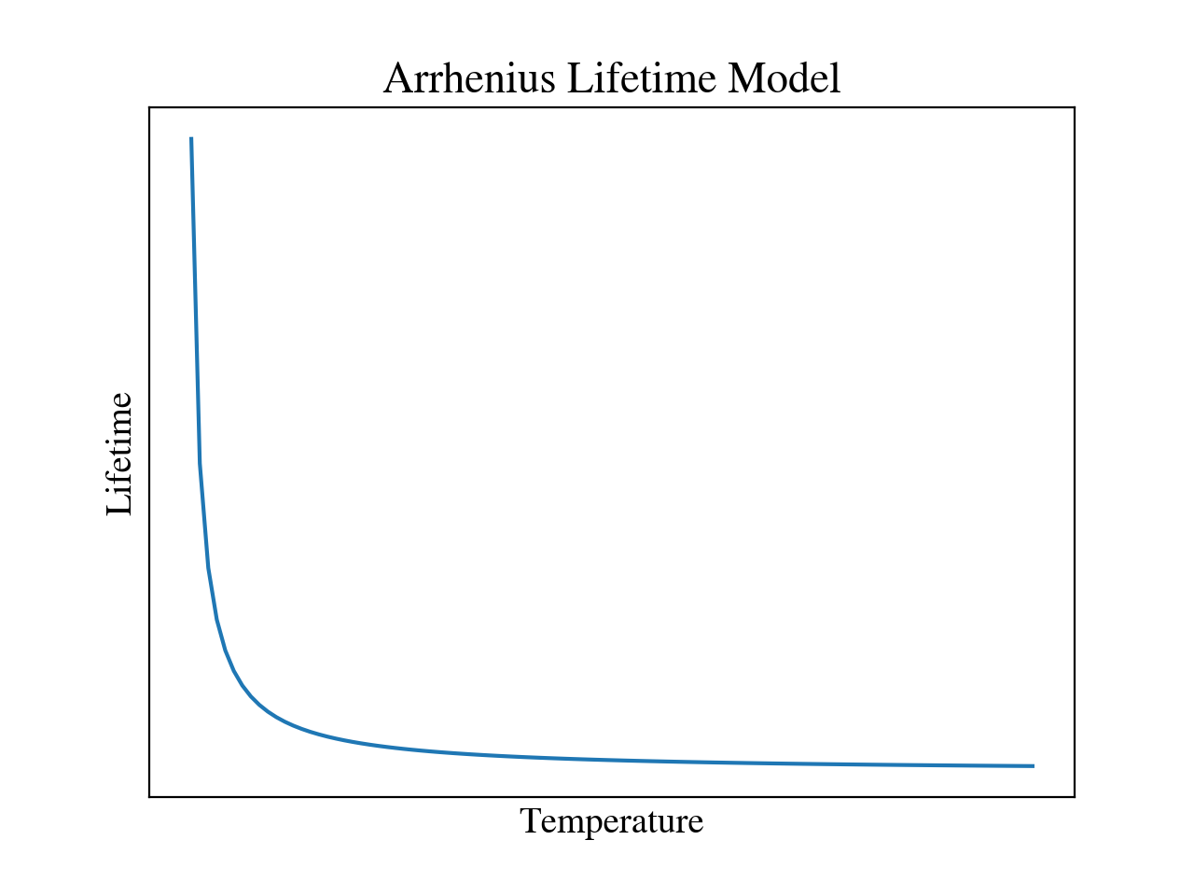
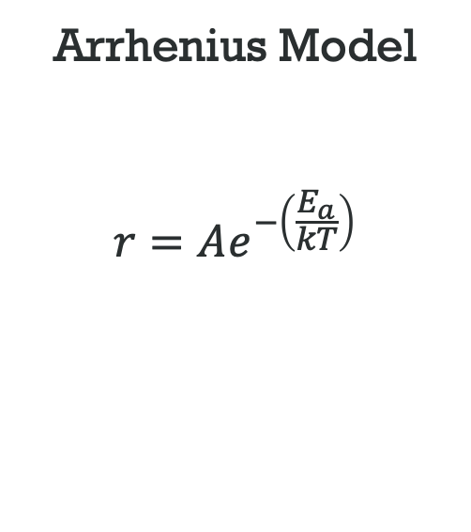
Thermal Management
Arrhenius Model
$$r=Ae^{−\left(\frac{E_{a}}{kT}\right)}$$
E. Elsayed
Motivation
Policy 1
Policy 2
Policy 3
Policy 4
Conclusion
Notes:
Thermal management is crucial to the modern world. As we use our cellphones, laptops, or other electronic devices, transistors are switched on and off within the central processing unit, or CPU. In their active state, current flows through the transistor and encounters resistance. This creates waste heat. On the scale of an individual transistor, this has a negligible effect on the device temperature. Modern CPUs, however, contain an ever-increasing number of transistors. For example, Apple’s M1 Ultra, released just this year, contains 114 billion transistors.
Therefore, the heat produced by CPUs can, during times of high usage, quickly increase the electronic device’s temperature.
Increased temperature has both short-term and long-term effects on device health. Increased device temperature can cause variations in electrical properties such as resistance, inductance, and capacitance, potentially causing errors in calculations. Additionally, electrical insulation may soften, corrosion occurs more quickly, and thermal expansion causes physical stress on components, potentially breaking them.
In the long term, thermal cycling can create cracks and other mechanical failures due to the continued increase and decrease in temperature.
In general, following the Arrhenius model, the lifetime of an electronic device decreases as the cycling temperature or static temperature increases. This is partially because the speed of chemical reactions increases with an increase in temperature, causing material and electronic failure over a shorter period of time.
This is a known problem, and solutions have been created to address it.

Slide 4
Existing Solutions
Dynamic Voltage and Frequency Scaling (DVFS)
Wang et al.
LeSueur et al.
Thread Allocation
Das et al.
Program Specific Optimizations
Lee et al.
Nguyen et al.
Motivation
Policy 1
Policy 2
Policy 3
Policy 4
Conclusion
Notes:
These solutions fall into three categories.
First, there is voltage scaling. A CPU core, a discrete processing unit within a multi-core system, operates at a specific clock frequency. This is the frequency at which it can accept and perform instructions. Therefore, when the clock frequency is lower, CPUs tend to perform fewer operations per second. Because the minimum required processor voltage is dependent on the frequency, the voltage can be reduced in tandem. This process is known as Dynamic Voltage and Frequency Scaling, or DVFS.
This process has two advantages. First, because it decreases the voltage supplied to the processor, the energy consumption of the device is reduced leading to higher efficiency. Second, it operates at a firmware level. In other words, it does not know which programs are running or how much CPU resources they are using, only that the temperature is too high and it needs to lower the processor frequency and voltage. Therefore, any program can be run on the device and the programmer does not need to worry about the CPU temperature.
Unfortunately, it also suffers from four problems. First, the temperature at which DVFS activates is static and determined by the device manufacturer. This provides little flexibility for designers that want to set a maximum temperature different from that used by DVFS. Second, DVFS operates independently of other programs running on the device and does not favor any specific task. Therefore, it is not possible to prioritize the CPU usage for different programs with just DVFS. Third, according to Wang et al., DVFS provides increasingly poor performance at high CPU usage levels, especially when CPU usage varies quickly. Finally, LeSueur et al. have found that, on modern computer platforms, traditional DVFS techniques can cause an increase in power usage, rather than a decrease.
Besides DVFS, there is also thread allocation. Fundamentally, a “thread” is an individual sequence of instructions which is performed simultaneously with, and independent from, another thread. A single thread can sometimes correspond to a single CPU core, or multiple threads can share a core. This concept becomes useful in the sphere of thermal management because threads can be assigned to different CPU cores if the temperature of a certain core gets too high. Das et al. created a policy via reinforcement learning to do just that, combined with frequency scaling. Their approach improved the mean time to failure, or MTTF, by 100 to 200%, depending on the system context.
Finally, there are programs which are designed to self-modify to optimize performance based on a set of criteria. This type of solution is especially relevant for computational tasks which require an especially large amount of CPU resources; particularly, object detection. Object detection is a sub-field of image processing that uses neural networks to locate and classify objects within images.
A recent example of this is the “Virtuoso” system designed by Lee et al. This program uses a form of Metareasoning, which I will discuss shortly, that modifies the size and shape of the neural network used for object detection to optimize for accuracy, energy, or speed requirements. It does not, however, consider temperature requirements.
Nguyen et al. proposed write something here
Therefore, I wanted to explore thermal management approaches that exist in the space not yet covered by the existing solutions. Particularly, I wanted to study how to do this for object detection algorithms considering the increasing popularity and computational intensity. The main research question I wanted to answer then, was: Is it possible to create a policy that can optimize object detection performance that operates within an image processing program, not the device firmware, given a user-defined and variable temperature constraint?

Slide 5
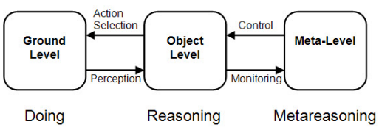
Metareasoning
Cox and Raja
Motivation
Policy 1
Policy 2
Policy 3
Policy 4
Conclusion
Notes:
To answer this question, a Metareasoning approach was used. Metareasoning is the concept of thinking about thinking; adjusting one’s own decision making process based on a higher-level context. This concept is prevalent in psychology and philosophy, but has become popular in computer science and engineering as autonomous agents have become increasingly viable thanks to computational advances.
Metareasoning is often able to offer increased performance by monitoring the agent and its decision-making environment to determine how to best approach its current decision. Without intervention, many programs operate toward the maximum confines of their environment. Autonomous rovers, for example, may travel at high speeds while searching an unknown environment, unknowingly shortening their battery life and leading to increased time between charging and shorter lifespans. Metareasoning provides a way for designers to help autonomous agents better understand the larger context of their mission so they can perform better in metrics for which they would otherwise not be able to account. In the case of this thesis, this means providing the object detection program with knowledge of the device temperature, processing throughput, and detection precision so that it can optimally perform its task under external constraints.

Slide 6
Metareasoning
Metareasoner Category | Policy
Designed | 1
 | 2
 | 3
Learned | 4
Motivation
Policy 1
Policy 2
Policy 3
Policy 4
Conclusion
Notes:
Policies 1, 2, and 3 were designed using knowledge of the system variables, while policy 4 was created using reinforcement learning.

Slide 7
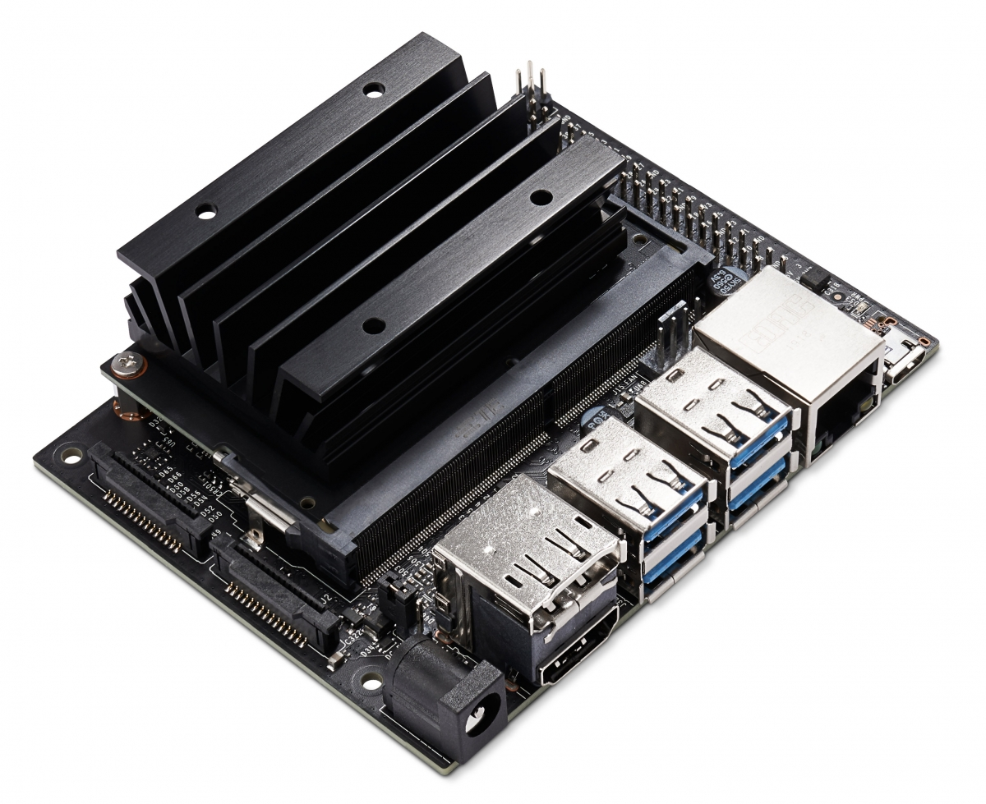
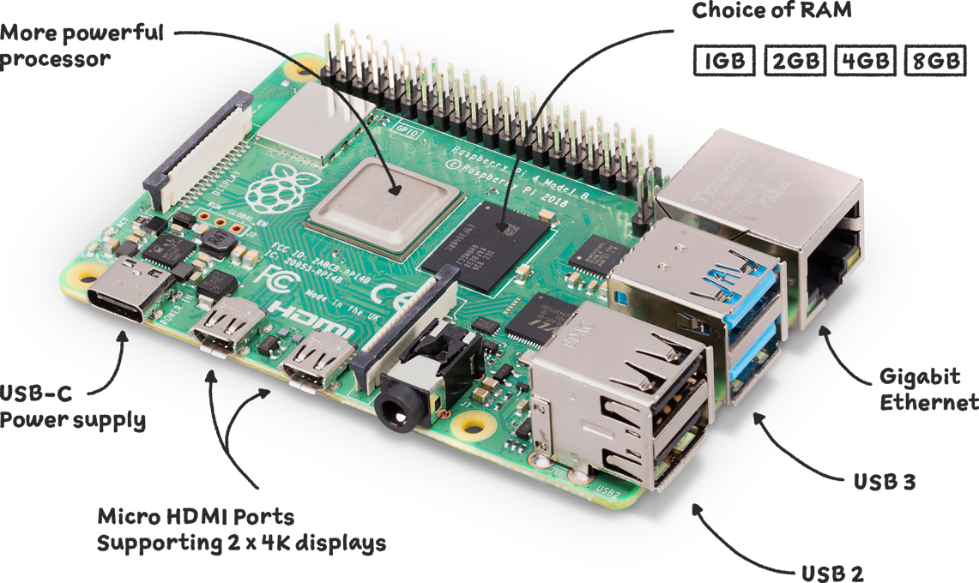
Approach
Python
OpenCV
TensorFlow
Raspberry Pi 4B
Jetson Nano Developer Kit
NVIDIA, Raspberry Pi Foundation
Motivation
Policy 1
Policy 2
Policy 3
Policy 4
Conclusion
Notes:
To answer this question, I created a set of programs in the Python programming language. Each program was designed to run a set of tests tailored to each policy to be explored. Each test was designed to run for a set amount of time, during which it would process an image, then perform adjustments to the program based on the policy.
All of the tests were performed on both a Raspberry Pi 4B and an NVIDIA Jetson Nano Developer Kit. The Raspberry Pi 4B is a popular consumer electronic device which is frequently used for small developer projects, while the Jetson Nano is a developer product created by NVIDIA, a GPU manufacturer and artificial intelligence company. It is designed to run neural networks efficiently, especially on the GPU. It should be noted, however, that the GPU was not used in these tests.

Slide 8
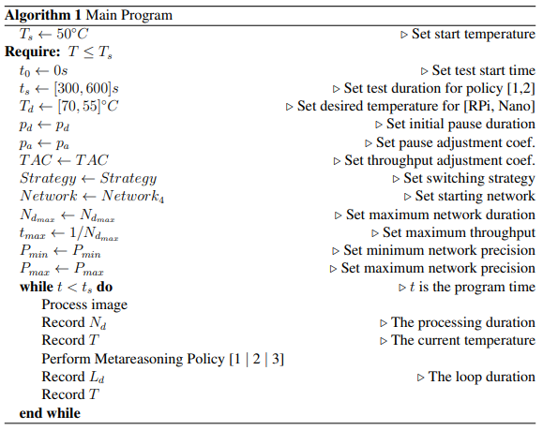
Approach
Motivation
Policy 1
Policy 2
Policy 3
Policy 4
Conclusion
Notes:
During each test, relevant data was recorded twice in each loop; once after the was image processed, then again after the policy actions were performed. This data included the current program time, the CPU temperature, graphics processing unit, or GPU, temperature if available, CPU usage, the image processing duration, the pause length, the total loop duration, and the current neural network being used.

Slide 9
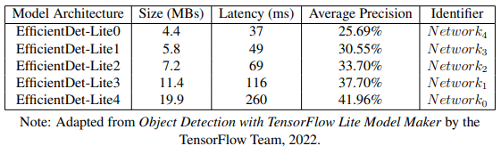
Object Detectors
EfficientDet [Tan et al.]
Motivation
Policy 1
Policy 2
Policy 3
Policy 4
Conclusion
Notes:
Some policies involved switching between different neural networks

Slide 10
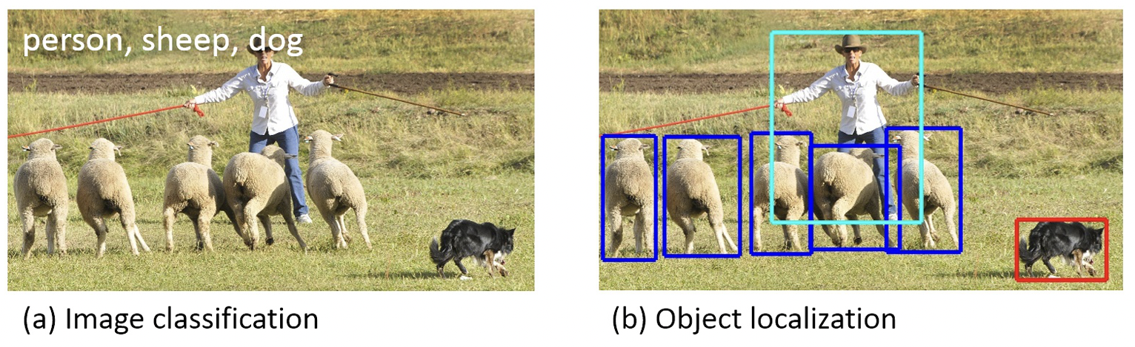
COCO Dataset
Lin et al.
Motivation
Policy 1
Policy 2
Policy 3
Policy 4
Conclusion
Notes:
Some policies involved switching between different neural networks

Slide 11
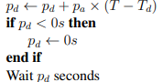
Policy 1
Constant Detection Precision
Dynamic Throughput
Motivation
Policy 1
Policy 2
Policy 3
Policy 4
Conclusion
Notes:
The first Metareasoning policy inserts a pause length after each image is processed. It also adjusts this pause length based on the current temperature error. This policy therefore maintains a constant

Slide 12
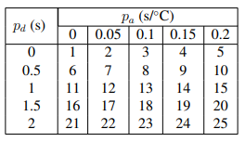
Policy 1 Tests
25 Tests per Network
125 Tests per Device
250 Tests Total
Motivation
Policy 1
Policy 2
Policy 3
Policy 4
Conclusion
Notes:
The first Metareasoning policy

Slide 13
Policy 1 Example
Setup
Desired Temperature = 70 ˚C
PAC = 0.2 s/˚C
Process Image
Measure Temperature (75 ˚C)
Pause = 0.1 + 0.2 (75 - 70) = 1.2s
Motivation
Policy 1
Policy 2
Policy 3
Policy 4
Conclusion

Slide 14
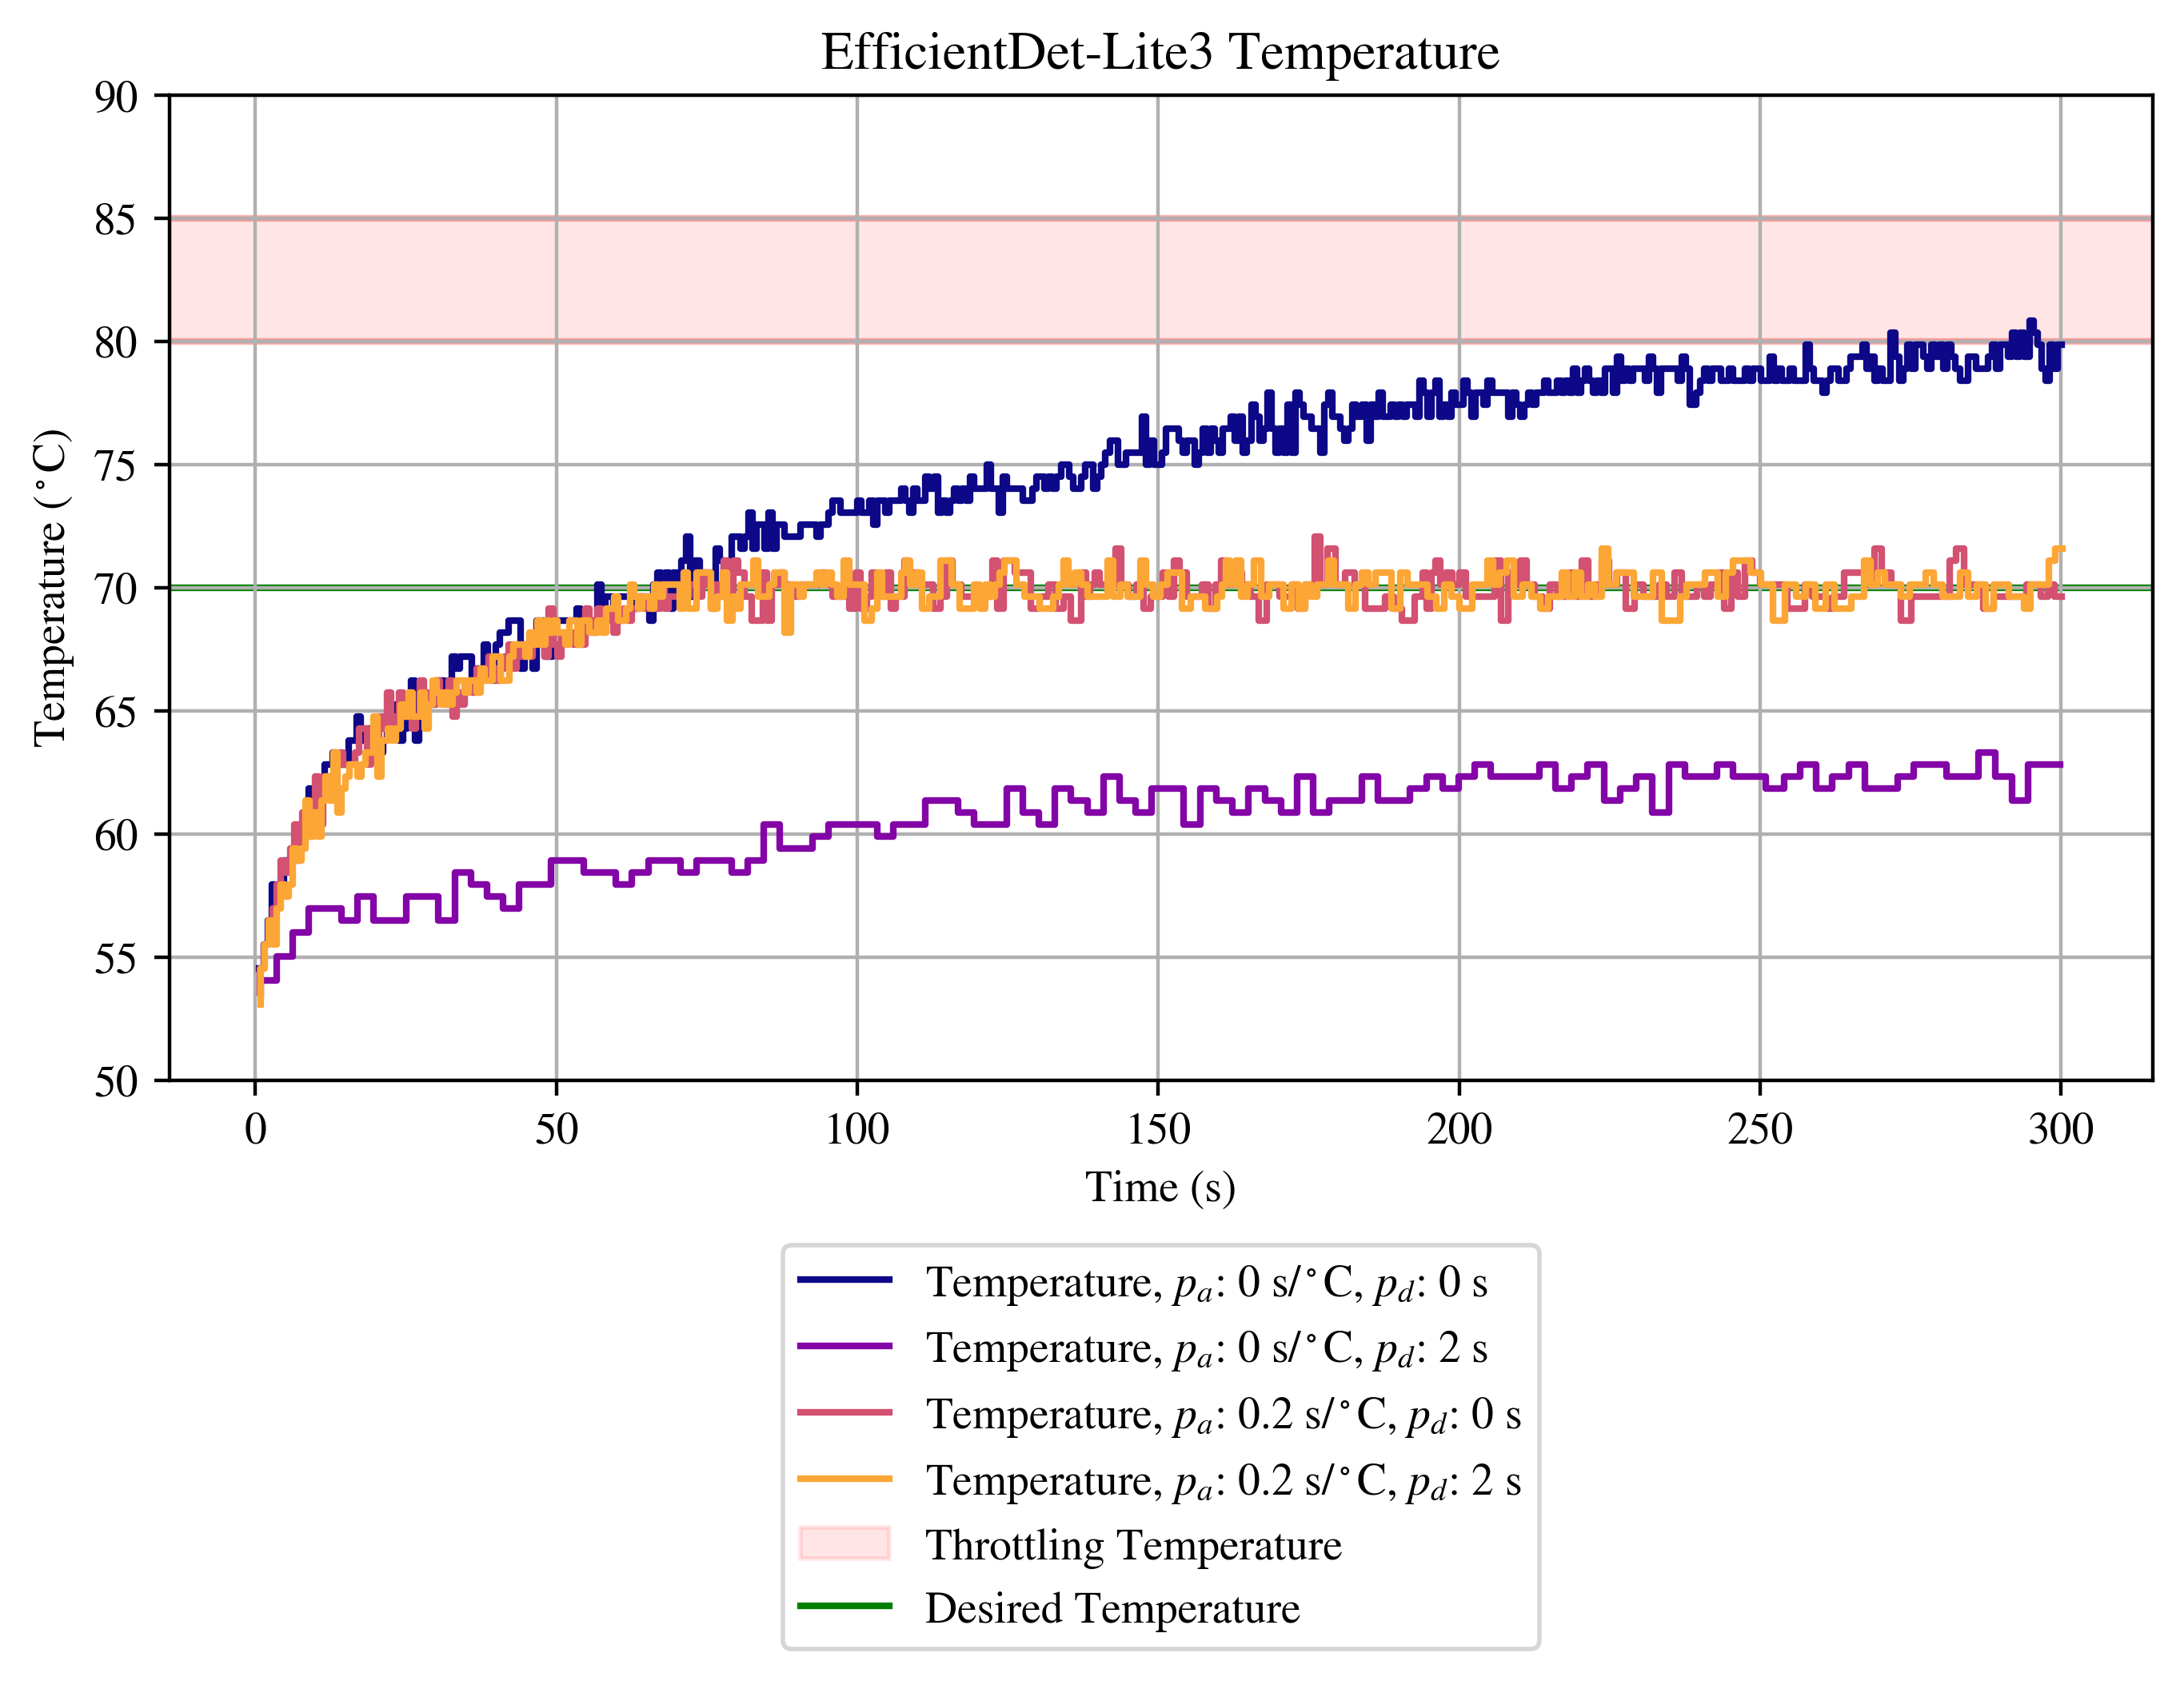
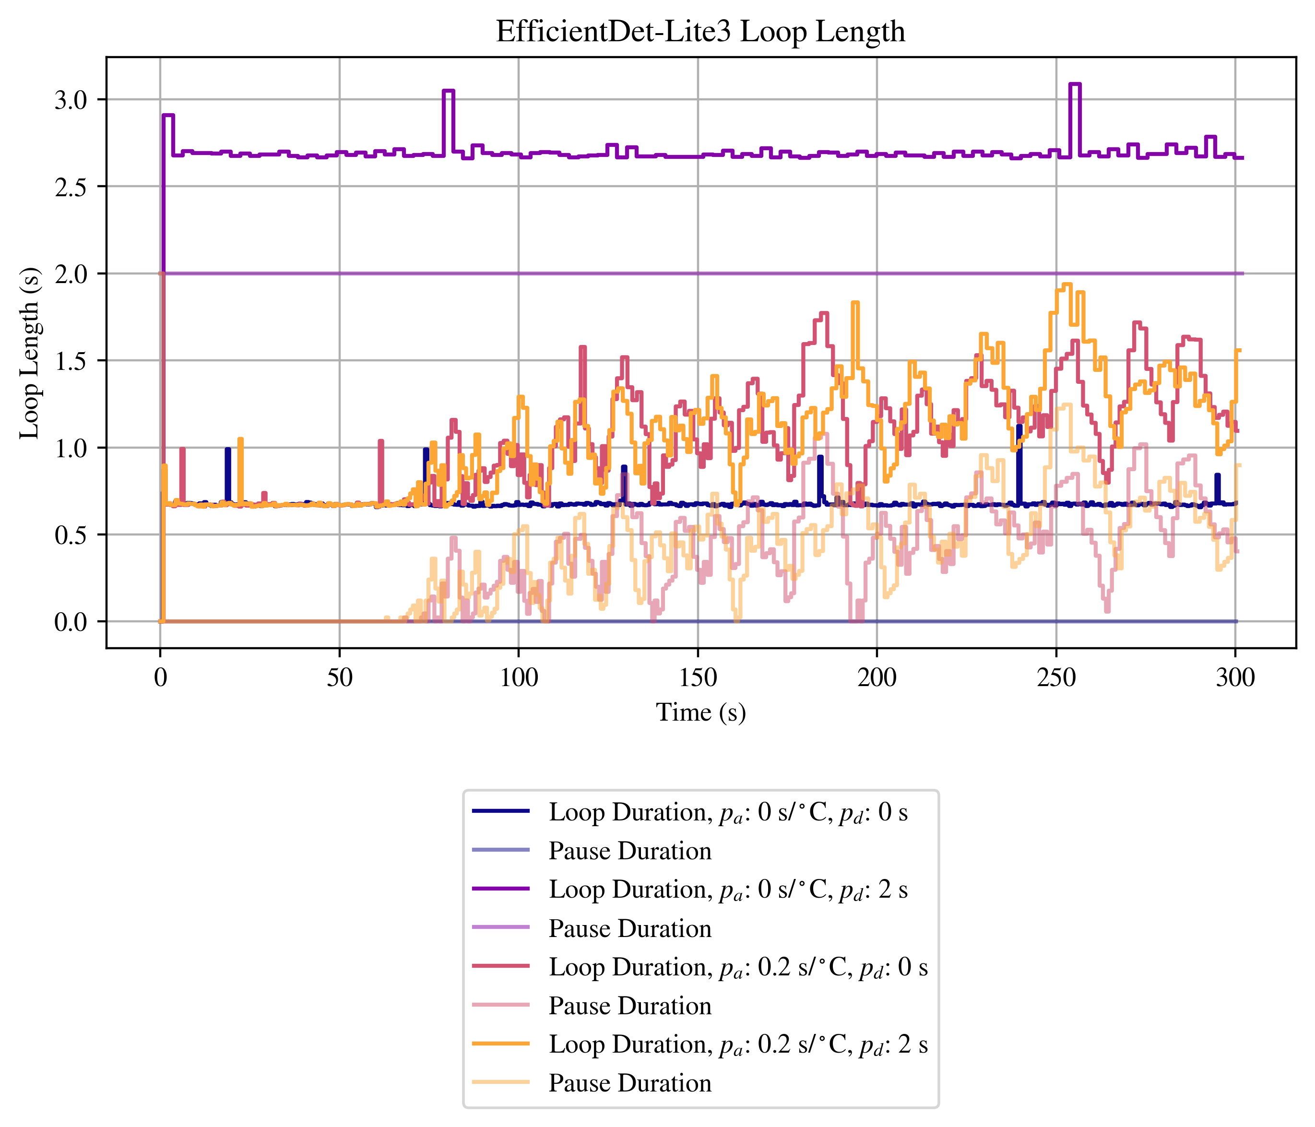
Policy 1, RPi, EDL-3
Motivation
Policy 1
Policy 2
Policy 3
Policy 4
Conclusion
Notes:
To showcase the results for policy 1, I will highlight a subset of four tests performed using the EfficientDet-Lite3 network on the Raspberry Pi.
Note that when Metareasoning was active, the initial pause duration didn’t matter for any test.

Slide 15
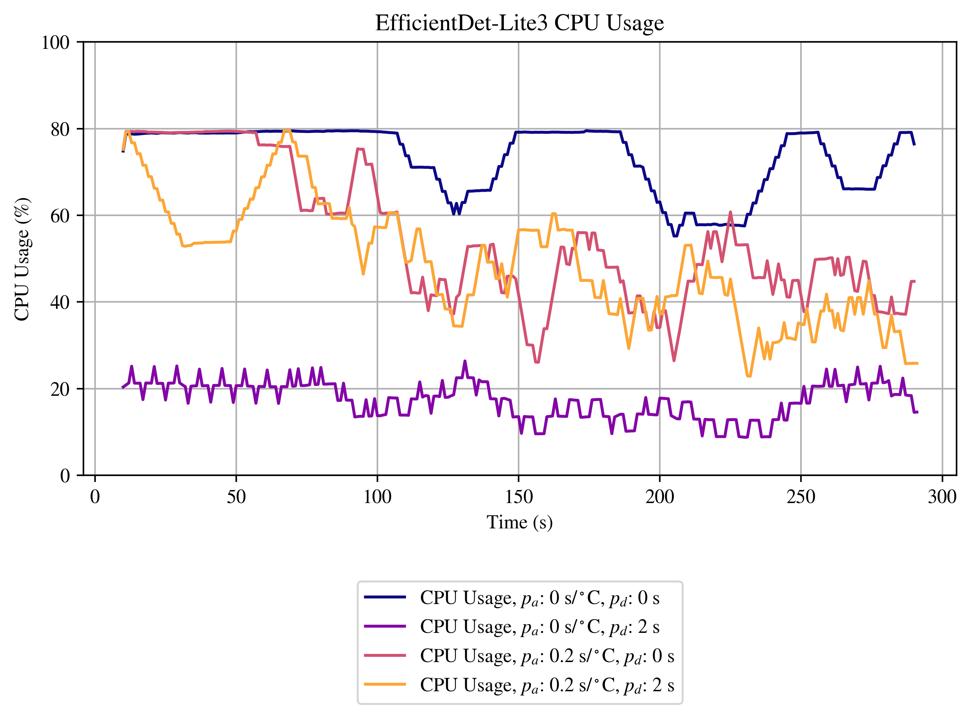
Policy 1, RPi, EDL-3
Motivation
Policy 1
Policy 2
Policy 3
Policy 4
Conclusion

Slide 16
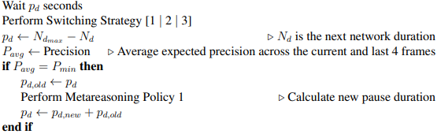
Policy 2
Constant Throughput
Dynamic Detection Precision
Motivation
Policy 1
Policy 2
Policy 3
Policy 4
Conclusion
Notes:
Policy 2 attempts

Slide 17
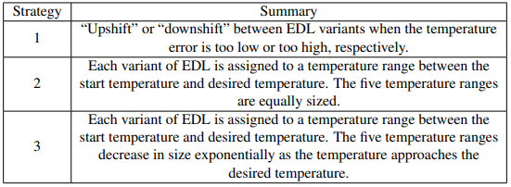
Policy 2 Switching Strategies
Motivation
Policy 1
Policy 2
Policy 3
Policy 4
Conclusion
Notes:
Three different switching strategies were implemented. The first strategy iterates through the set of networks in order of descending or ascending computational complexity, the second, the networks to a linearly scaling range of temperatures, and the third assigns the networks to a range of exponentially scaling temperature ranges.
1 test was performed for each strategy.

Slide 18
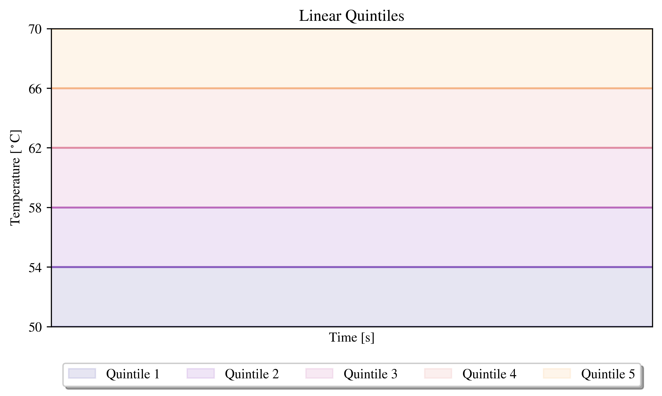
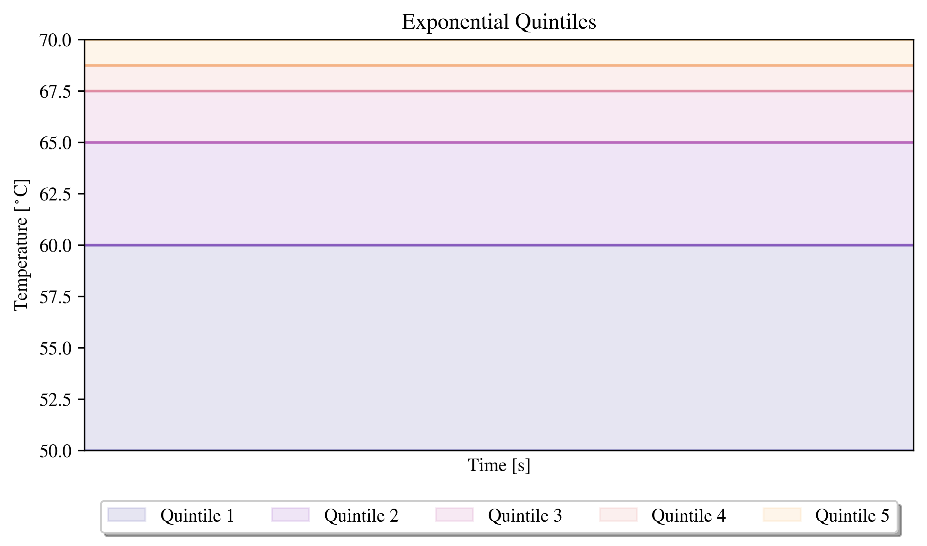
Policy 2 Switching Strategies
Motivation
Policy 1
Policy 2
Policy 3
Policy 4
Conclusion

Slide 19
Policy 2, Strategy 1 Example
Setup
Desired Temperature = 70 ˚C
Process Image using EfficientDet-Lite3
Measure Temperature (75 ˚C)
Next Network = EfficientDet-Lite2
Motivation
Policy 1
Policy 2
Policy 3
Policy 4
Conclusion

Slide 20
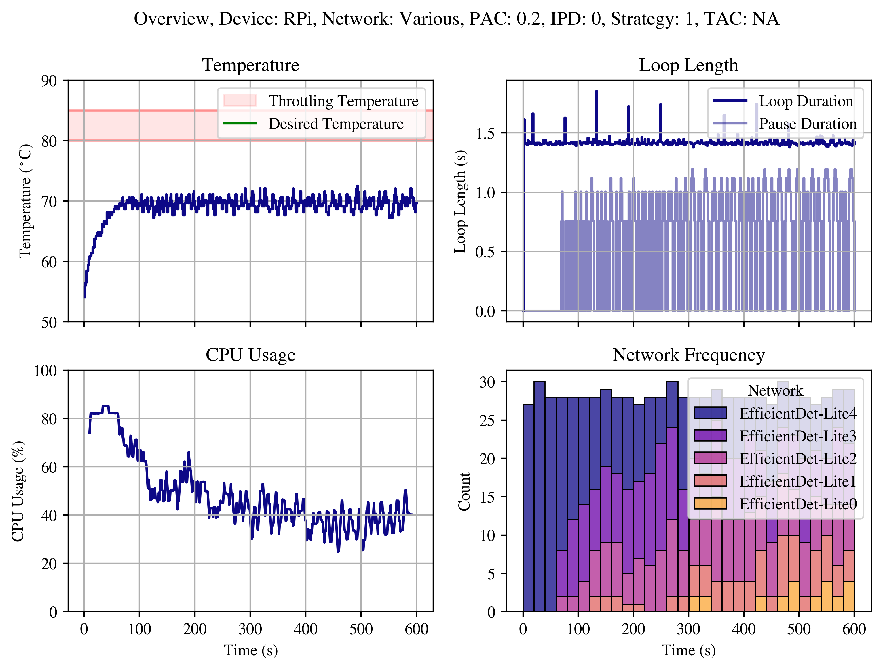
Policy 2 Results, RPi, Strategy 1
Motivation
Policy 1
Policy 2
Policy 3
Policy 4
Conclusion
Notes:
Note that there are occasional spikes in the loop length (inversed throughput). These likely correspond to periodic background tasks performed by the raspberry Pi which request additional CPU usage, therefore increasing the processing duration. The program is running on the Raspbian operating system, which is additionally tasked with communicating with remote viewers via the RealVNC (Virtual Network Computing) software, for example.
While switching strategy 1 optimizes the image processing loop to use maximum precision for as long as possible.

Slide 21
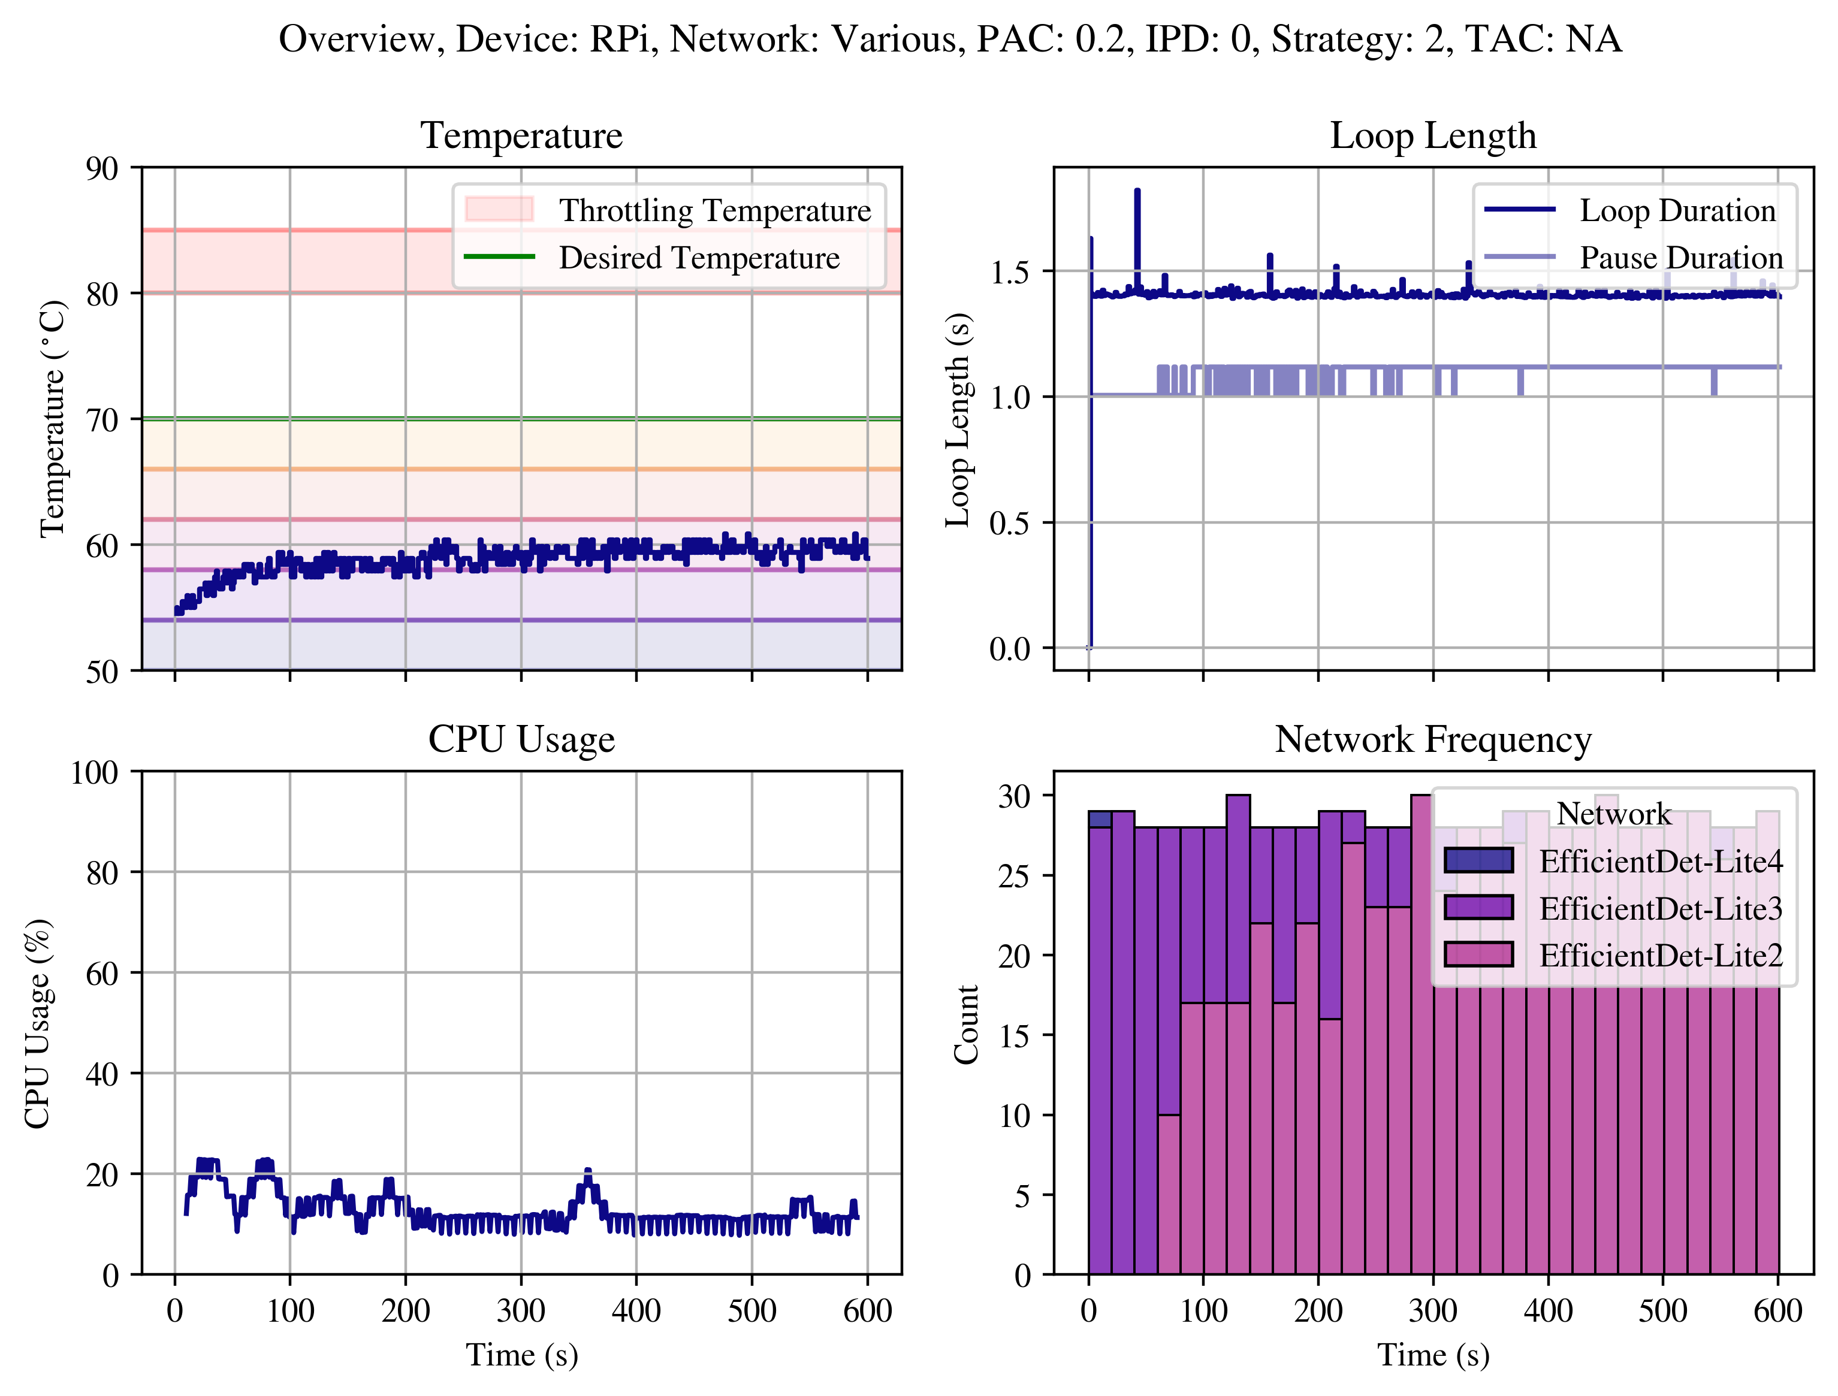
Policy 2 Results, RPi, Strategy 2
Motivation
Policy 1
Policy 2
Policy 3
Policy 4
Conclusion
Notes:
strategies 2 and 3 operate at lower temperatures for a longer duration, sacrificing a surplus of detection precision for lower average temperature, seen in Figures 3.36 and 3.36. Switching strategy 3 more closely approaches the success of switching strategy 1.

Slide 22
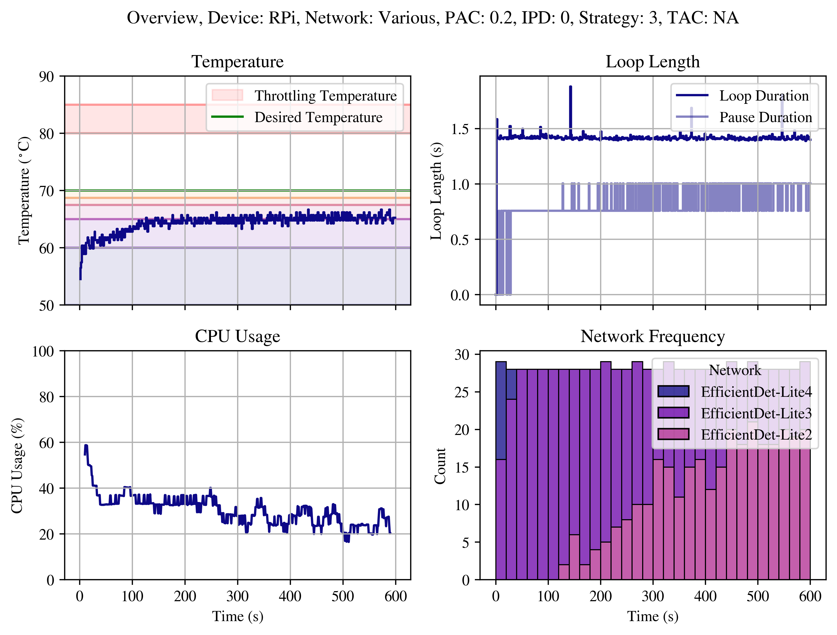
Policy 2 Results, RPi, Strategy 3
Motivation
Policy 1
Policy 2
Policy 3
Policy 4
Conclusion
Notes:
The results for policy 2 show that a constant throughput is successfully maintained over the course of the tests for each swtiching strategy on both the RPi and the Nano.
Results for policy 2 are similar on the Nano, with switching strategy 1 successfully optimizing precision while constrained by a minimum throughput and maximum temperature. Again, spikes in the program loop length can be seen in the Nano, likely caused by similarly periodic background tasks.

Slide 23
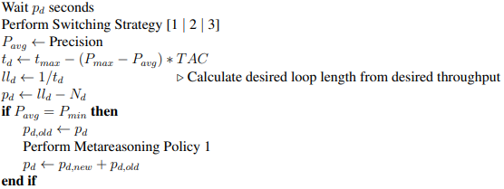
Policy 3
Dynamic Detection Precision
Dynamic Throughput
Motivation
Policy 1
Policy 2
Policy 3
Policy 4
Conclusion

Slide 24
Policy 3, Strategy 1 Example
Setup: Desired Temperature = 70 ˚C, TAC = 1
Process Image using EfficientDet-Lite3
Measure Temperature (75 ˚C)
Next Network = EfficientDet-Lite2
Update Average Network Precision (0.32)
Pause Duration = 0.5 + (0.42 – 0.32)(1) = 0.6s
Motivation
Policy 1
Policy 2
Policy 3
Policy 4
Conclusion

Slide 25
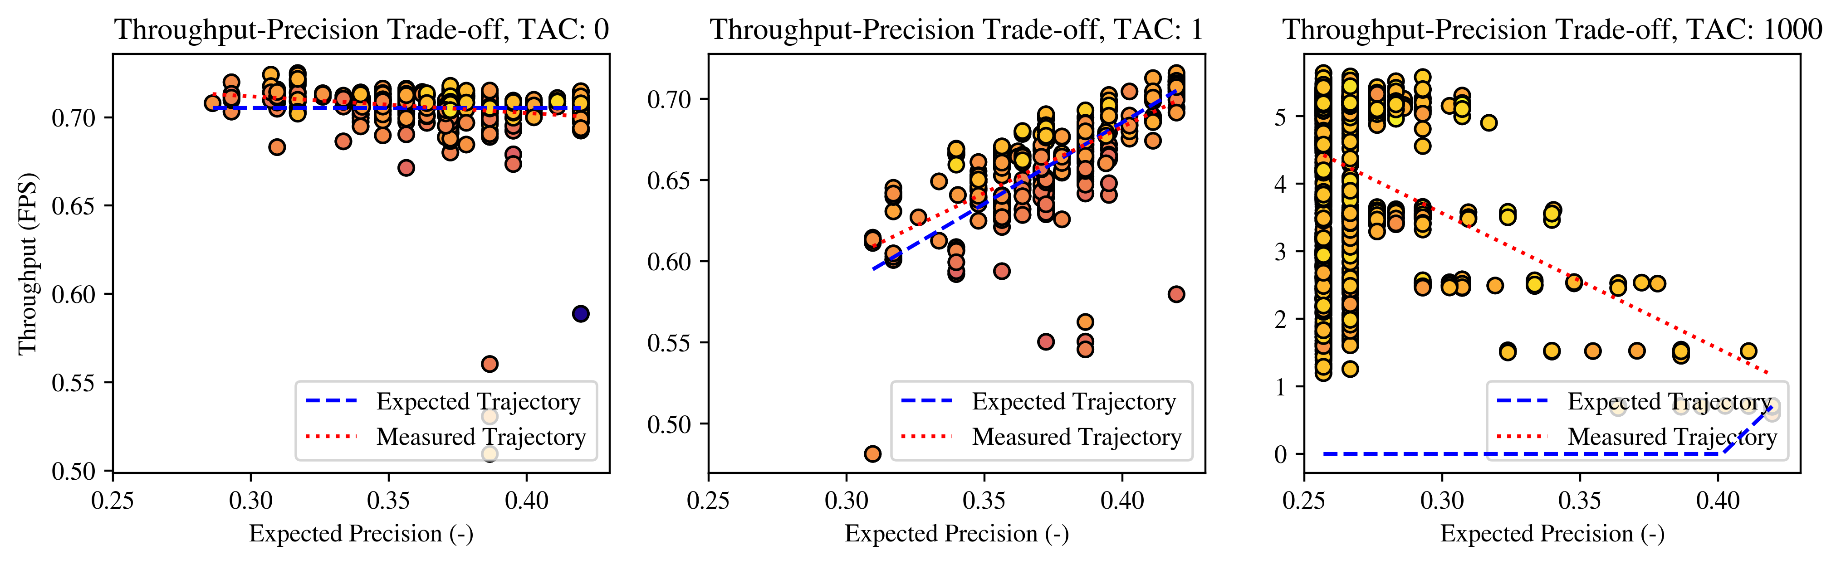
Policy 3 Results, Strategy 1
Motivation
Policy 1
Policy 2
Policy 3
Policy 4
Conclusion
Notes:
The results for policy 3 show that, in some cases, the strategy is successful in generalizing the problem. For example, Figures 3.41, 3.42, and 3.43, where T AC = 0, successfully mimic metareasoning policy 2. For tests where TAC = 1, results are similar to that of AC = 0 but the throughput slowly increases over time, representing the 1:1 sacrifice of precision to throughput. This is seen in Figures 3.44, 3.45, and 3.46
For tests where T AC = 1000, the results were unexpected. With a TAC so high, it was expected that as networks with lower expected detection precision were used, the throughput would drastically decrease, causing long pauses where the device would be able to cool down. This would, therefore, incentive the use EfficientDet-Lite4 and somewhat mimic metareasoning policy 1. The opposite of this occurred, seen in Figures 3.47, 3.48, and 3.49. This is due to an oversight in the pause duration calculation in policy 3. As seen in Algorithm 7, the desired loop length is assigned the inverse of the desired throughput, which itself is assigned by subtracting the product of the precision loss and TAC from the maximum throughput. With high TACs, it is therefore possible to obtain a negative desired throughput and a corresponding loop length with negative duration. The pause length is then assigned a negative value which, to prevent the breaking of the loop, is set to zero. Therefore, the TAC parameter for policy 3 must be tuned to a value such that when the precision reaches its minimum the desired throughput is a positive, if small value.

Slide 26
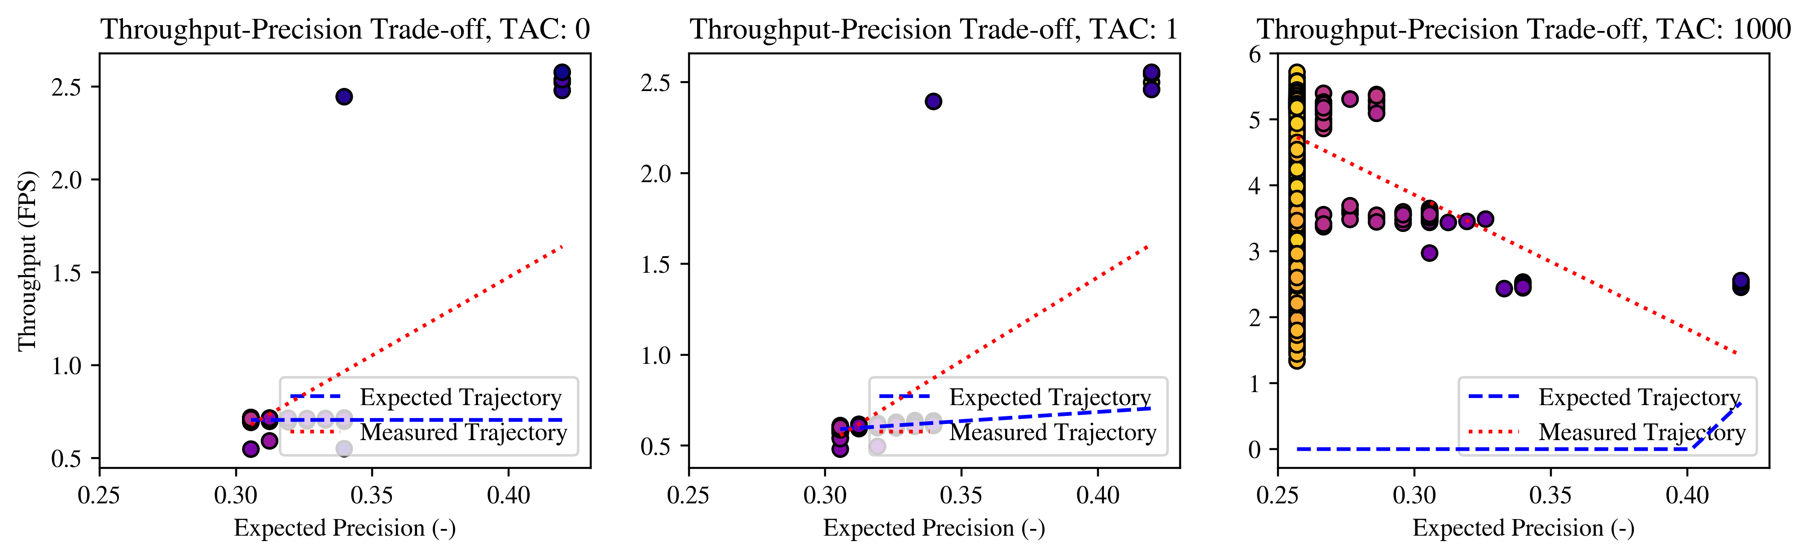
Policy 3 Results, Strategy 2
Motivation
Policy 1
Policy 2
Policy 3
Policy 4
Conclusion

Slide 27
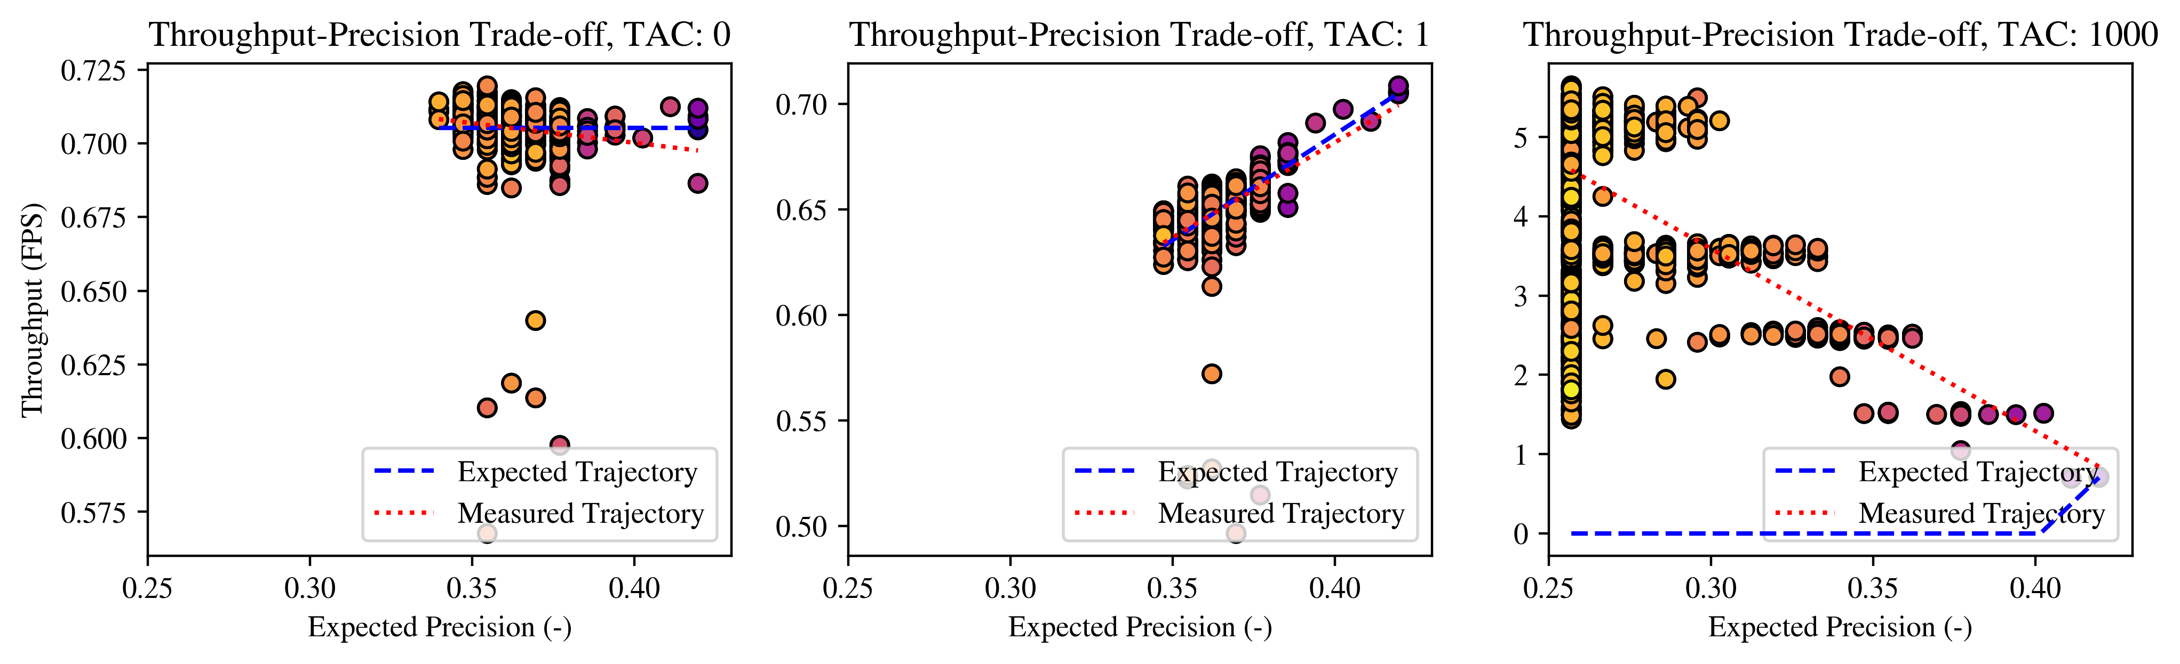
Policy 3 Results, Strategy 3
Motivation
Policy 1
Policy 2
Policy 3
Policy 4
Conclusion

Slide 28
Policy 4 States and Actions
States
Temperature
Pause Duration
Neural Network
Actions
No change
Upshift Network
Downshift Network
Adjust Pause Length (Policy 1, PAC = 0.2)
Motivation
Policy 1
Policy 2
Policy 3
Policy 4
Conclusion

Slide 29
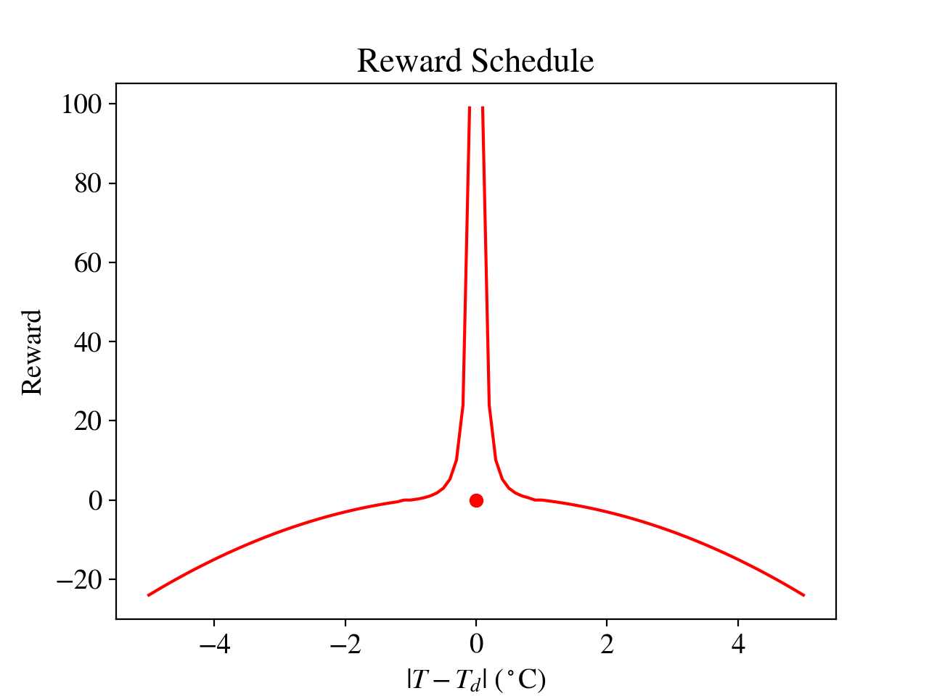
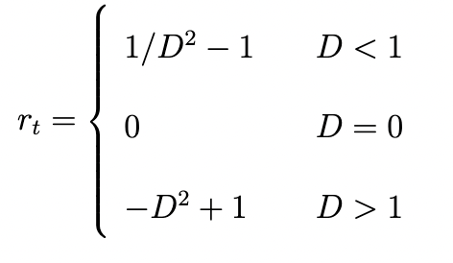

Policy 4 Rewards
$$D=|T−T_{d}|$$
Motivation
Policy 1
Policy 2
Policy 3
Policy 4
Conclusion

Slide 30
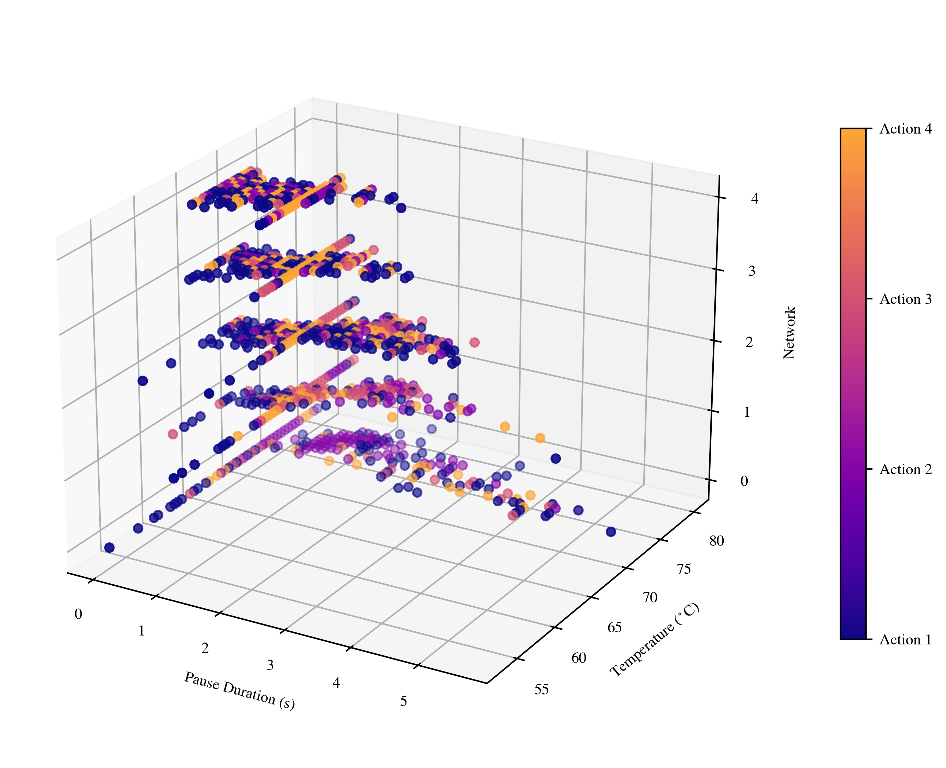
Policy 4, RPi Training
Motivation
Policy 1
Policy 2
Policy 3
Policy 4
Conclusion
Notes:
The results from the Q-table training provide policy maps full of information. Figure 4.1, the RPi policy map, shows concentrations of state-action pairs around a temperature of 70 ◦C, the desired temperature. This is likely caused by the drastic change in the provided reward as the temperature gets further from the desired temperature. If the reinforcement learning agent “steps” away from the desired temperature by more than 1 ◦C, it will be assigned a large negative award. Therefore, the agent tended to stay near the desired temperature unless it was exploring.
Additionally, the amount of desirable actions learned tends to positively correspond to the pause duration associated with each network. Therefore, as the network index increases from 0 to 4, the pause duration where learned state-action values are most dense corresponds to the maximum loop length minus the expected network duration. Variations in the pause duration associated with each state-action value tend to increase as the desired temperature is reached.
Qualitatively, action 2 seems to be the best choice for many states when EDL-4 is in use and the temperature is higher than the desired temperature. This means that when the temperature was too high and the network EDL-4 is in use, the agent learned to switch to EDL-3. This is analogous to what is performed during metareasoning policy 2.

Slide 31
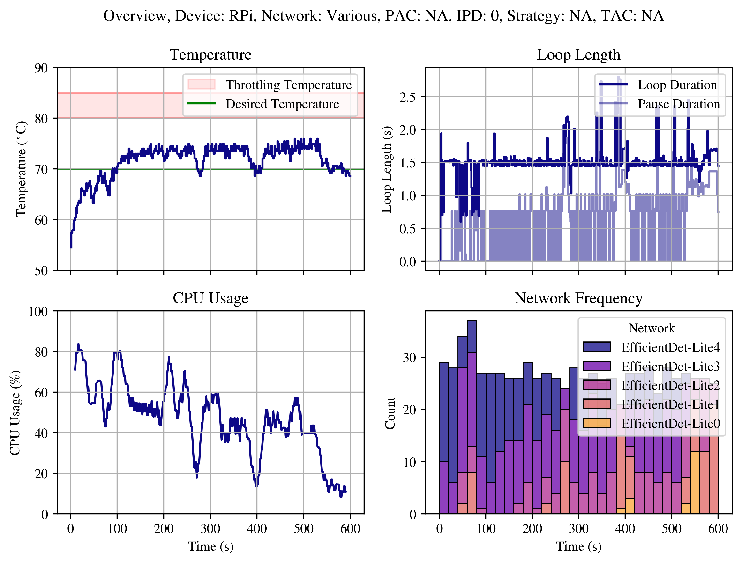
Policy 4 Results, RPi
Motivation
Policy 1
Policy 2
Policy 3
Policy 4
Conclusion
Notes:
Figure 4.2 shows that the policy was successful in maintaining a certain temperature, but not consistently. The policy trends towards using less computationally intensive neural networks while occasionally adjusting the pause length to bring the temperature from highs around 75 ◦C to below the threshold. This is not an optimal strategy, but mimics trends seen in policy 1 and 2 to some success.

Slide 32
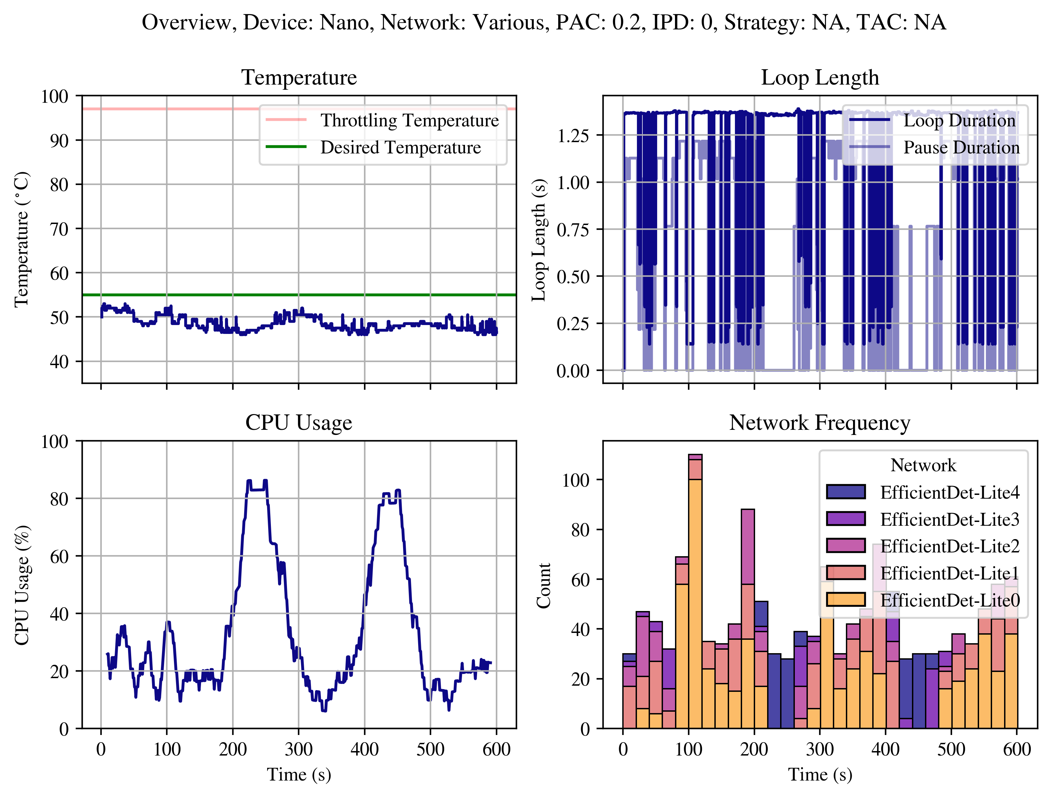
Policy 4 Results, Nano
Motivation
Policy 1
Policy 2
Policy 3
Policy 4
Conclusion
Notes:
Figure 4.2 shows that the policy was successful in maintaining a certain temperature, but not consistently. The policy trends towards using less computationally intensive neural networks while occasionally adjusting the pause length to bring the temperature from highs around 75 ◦C to below the threshold. This is not an optimal strategy, but mimics trends seen in policy 1 and 2 to some success.

Slide 33
Conclusion
Policies 1, 2, and 3: Successful
Policy 4: More Training Required
Future Work
Motivation
Policy 1
Policy 2
Policy 3
Policy 4
Conclusion
Notes:
Results from testing on the Raspberry Pi 4B and NVIDIA Jetson Nano Developer Kit demonstrate that all three designed metareasoning policies, given the right input parameters, able to stabilize the temperature of their device during processing. Policy 1 is able to do so for any value of pause adjustment coefficient, no matter the initial pause duration. Policy 2 is able to do so with any switching strategy, though only switching strategy 1 is able to maximize the average detection precision given minimum throughput and maximum temperature constraints. For most input parameters, policy 3 is able to stabilize the device temperature. Careful consideration of the TAC is required before using this policy for consistent temperature stability. In the case of EDL-[0-4], a TAC between zero and four can provide a throughput-precision trade-off tailored to the user’s preference.
Results for policy 4 show some success in maintaining a constant temperature, though neither device-specific policy maximized detection precision or maintained a consistent throughput while doing so.
These policies are advantageous because they are able to consistently stabilize temperatures across devices
Future work in this area may involve more variants on the policies listed in this thesis. Insight could be gathered from testing policies 1 and 3 with a wider range of input parameters. Policy 2 may benefit from the addition of more neural networks, the testing of networks with purposes other than object detection, or additional switching strategies. An additional direction of research may involve modifying policy 3 so that it is viable at a larger range of TAC values. Finally, there is much potential for reinforcement learning or other machine learning strategies to improve upon policy 4. Additional training time, larger action set, precision-based rewards, or increased variation in training parameters could lead to a more consistently successful version of this policy.

Slide 34
Michael Dawson
10427 Montrose Ave. Apt. 2, Bethesda, MD 20814
301.784.6247 / mdawson4@umd.edu
Notes:
I would like to thank Dr. Herrmann for his assistance throughout my time as a graduate student at the University of Maryland.
I’d also like to thank my family and friends for supporting me during the good times and the not so good times.
I’d like to thank the Army Research Laboratory for their funding of my Research Assistantship, as well as Ivan Penskiy of the Maryland Robotics Realization Lab for use of the Jetson Nano.
And finally, I’d like to thank my committee for taking the time to read my thesis and listen to my presentation today.
I’m happy to take any questions

Slide 35
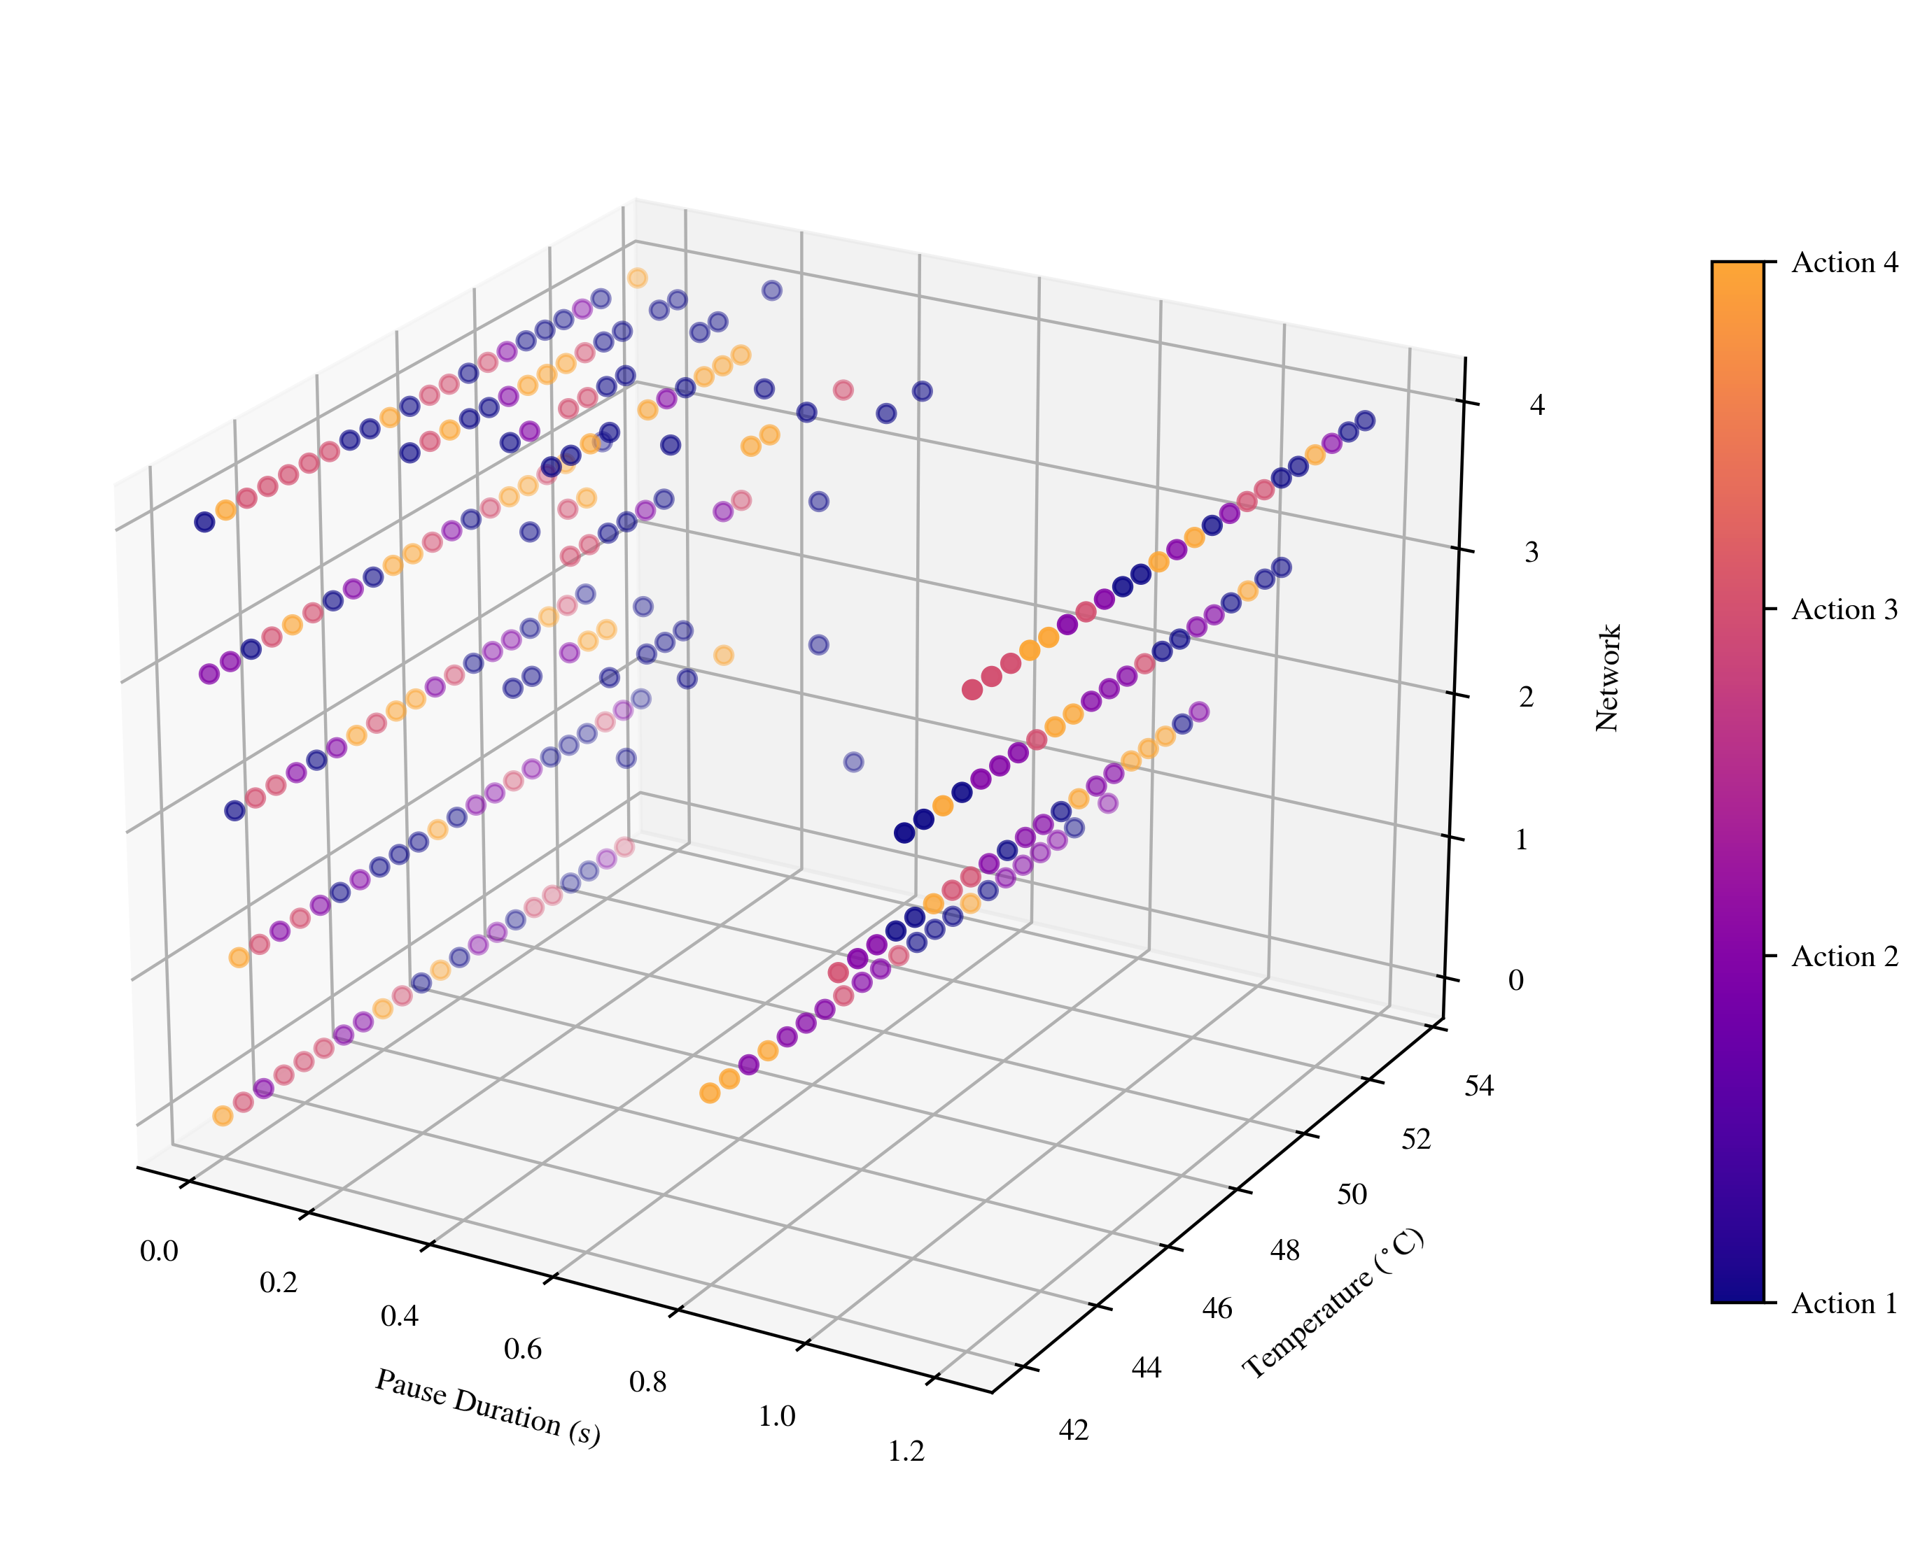
Backup Slide A

Slide 36
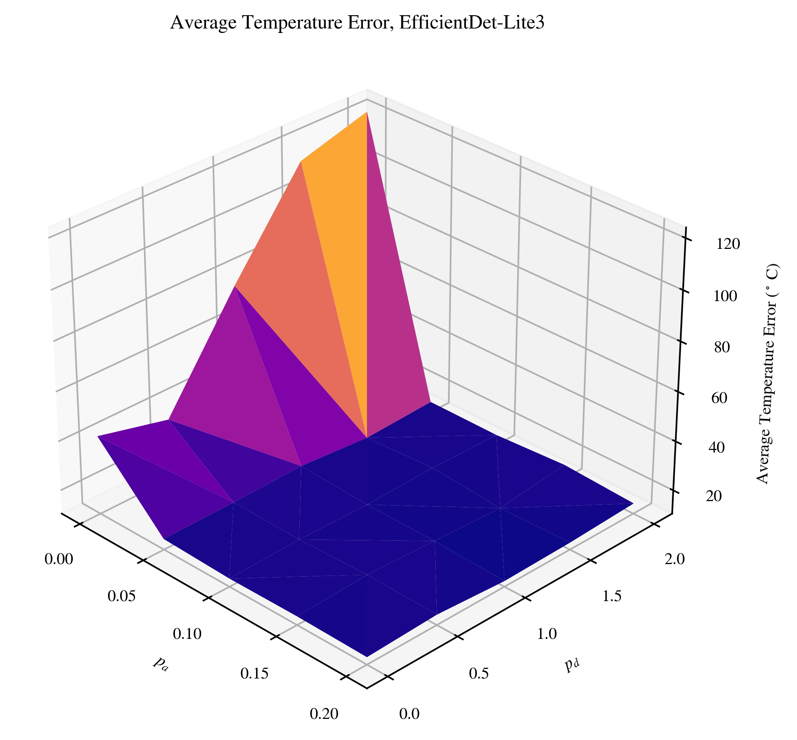
Backup Slide B

Slide 37
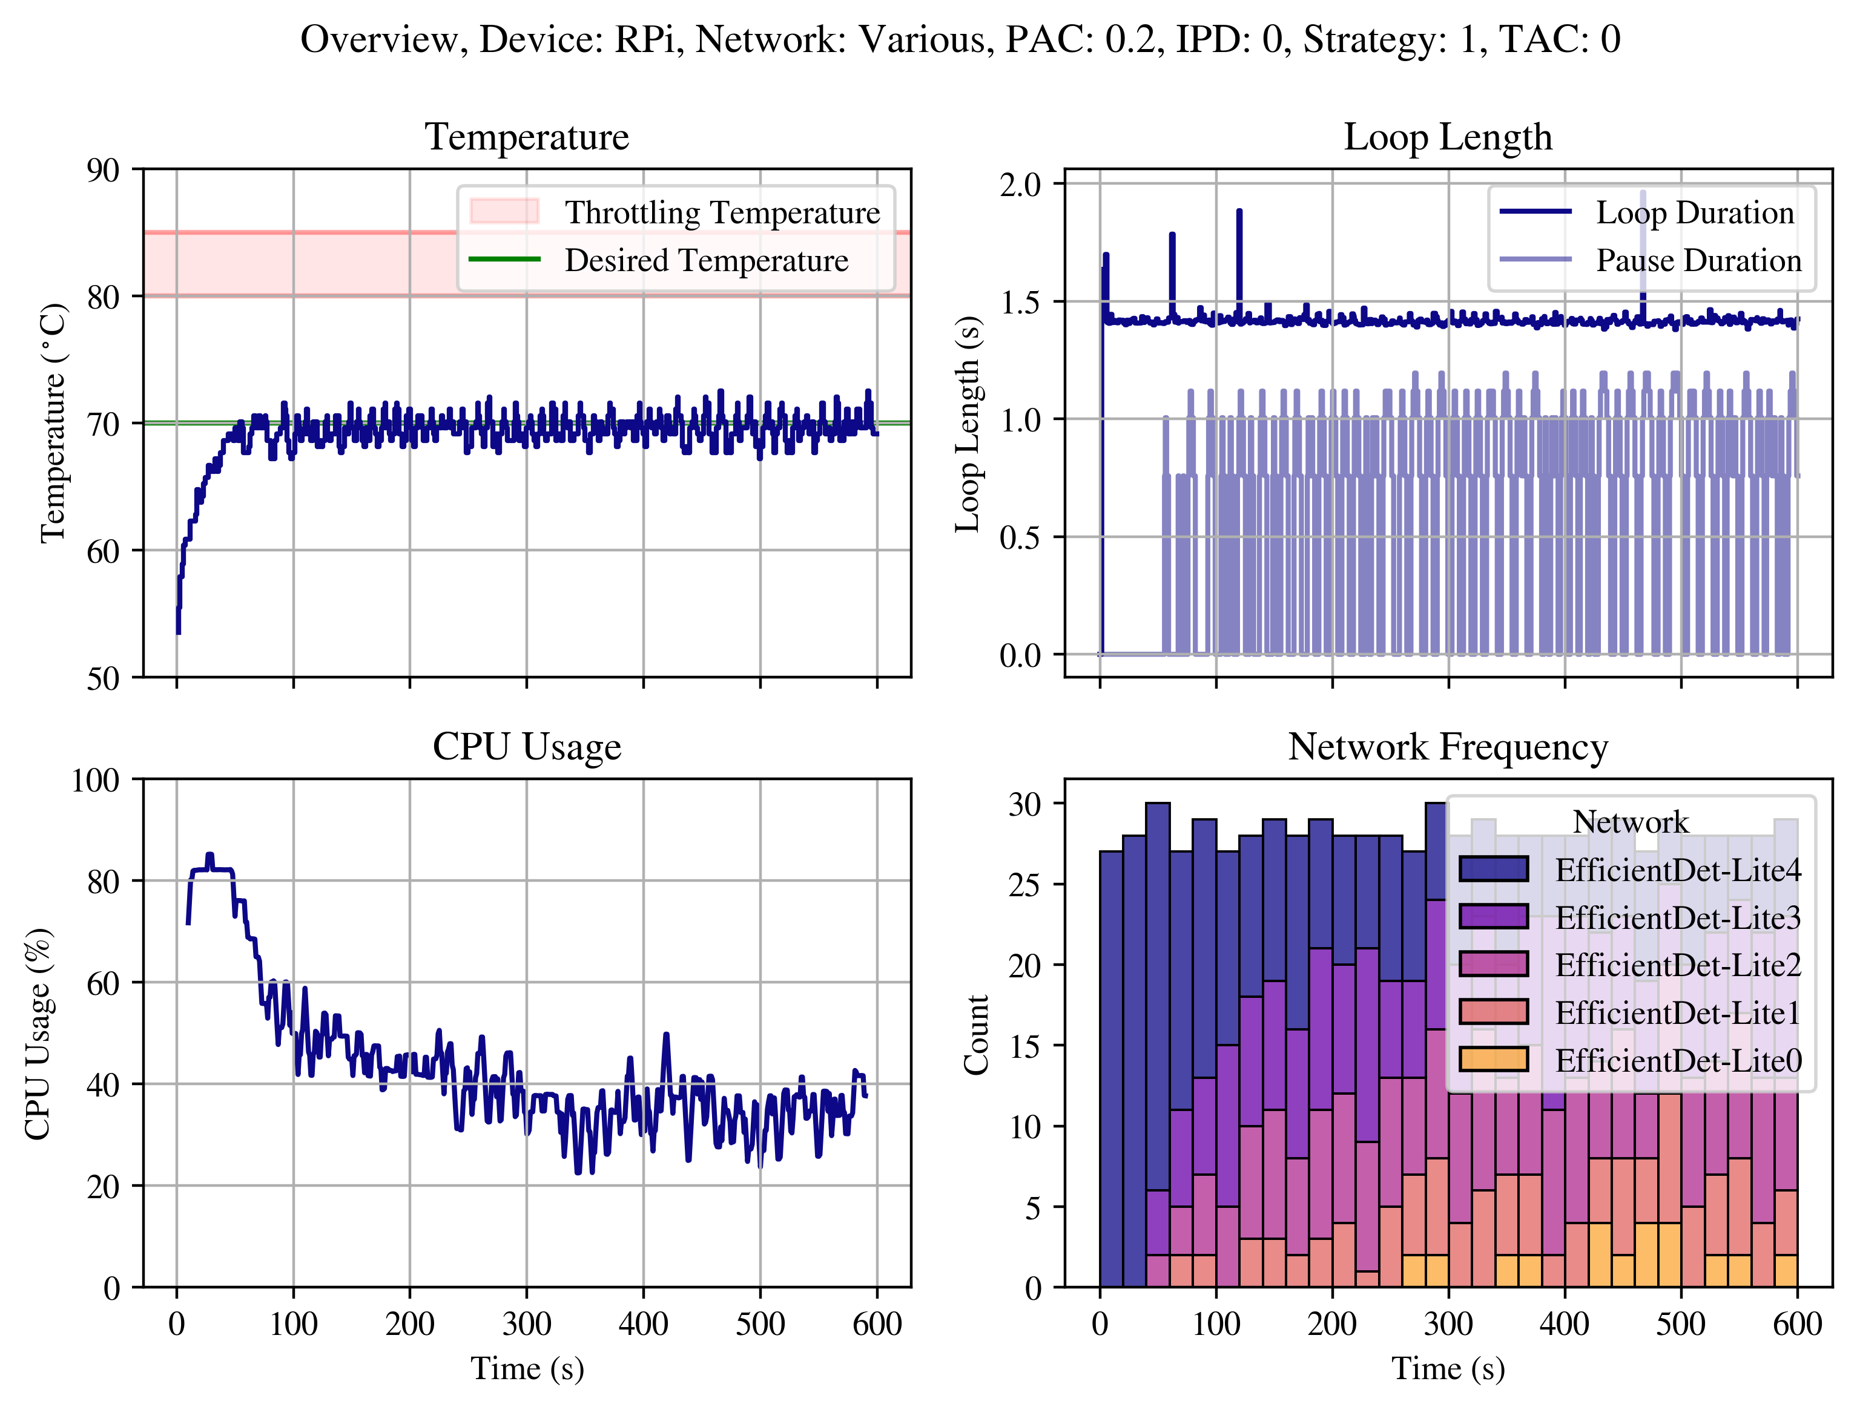
Backup Slide C

Slide 38
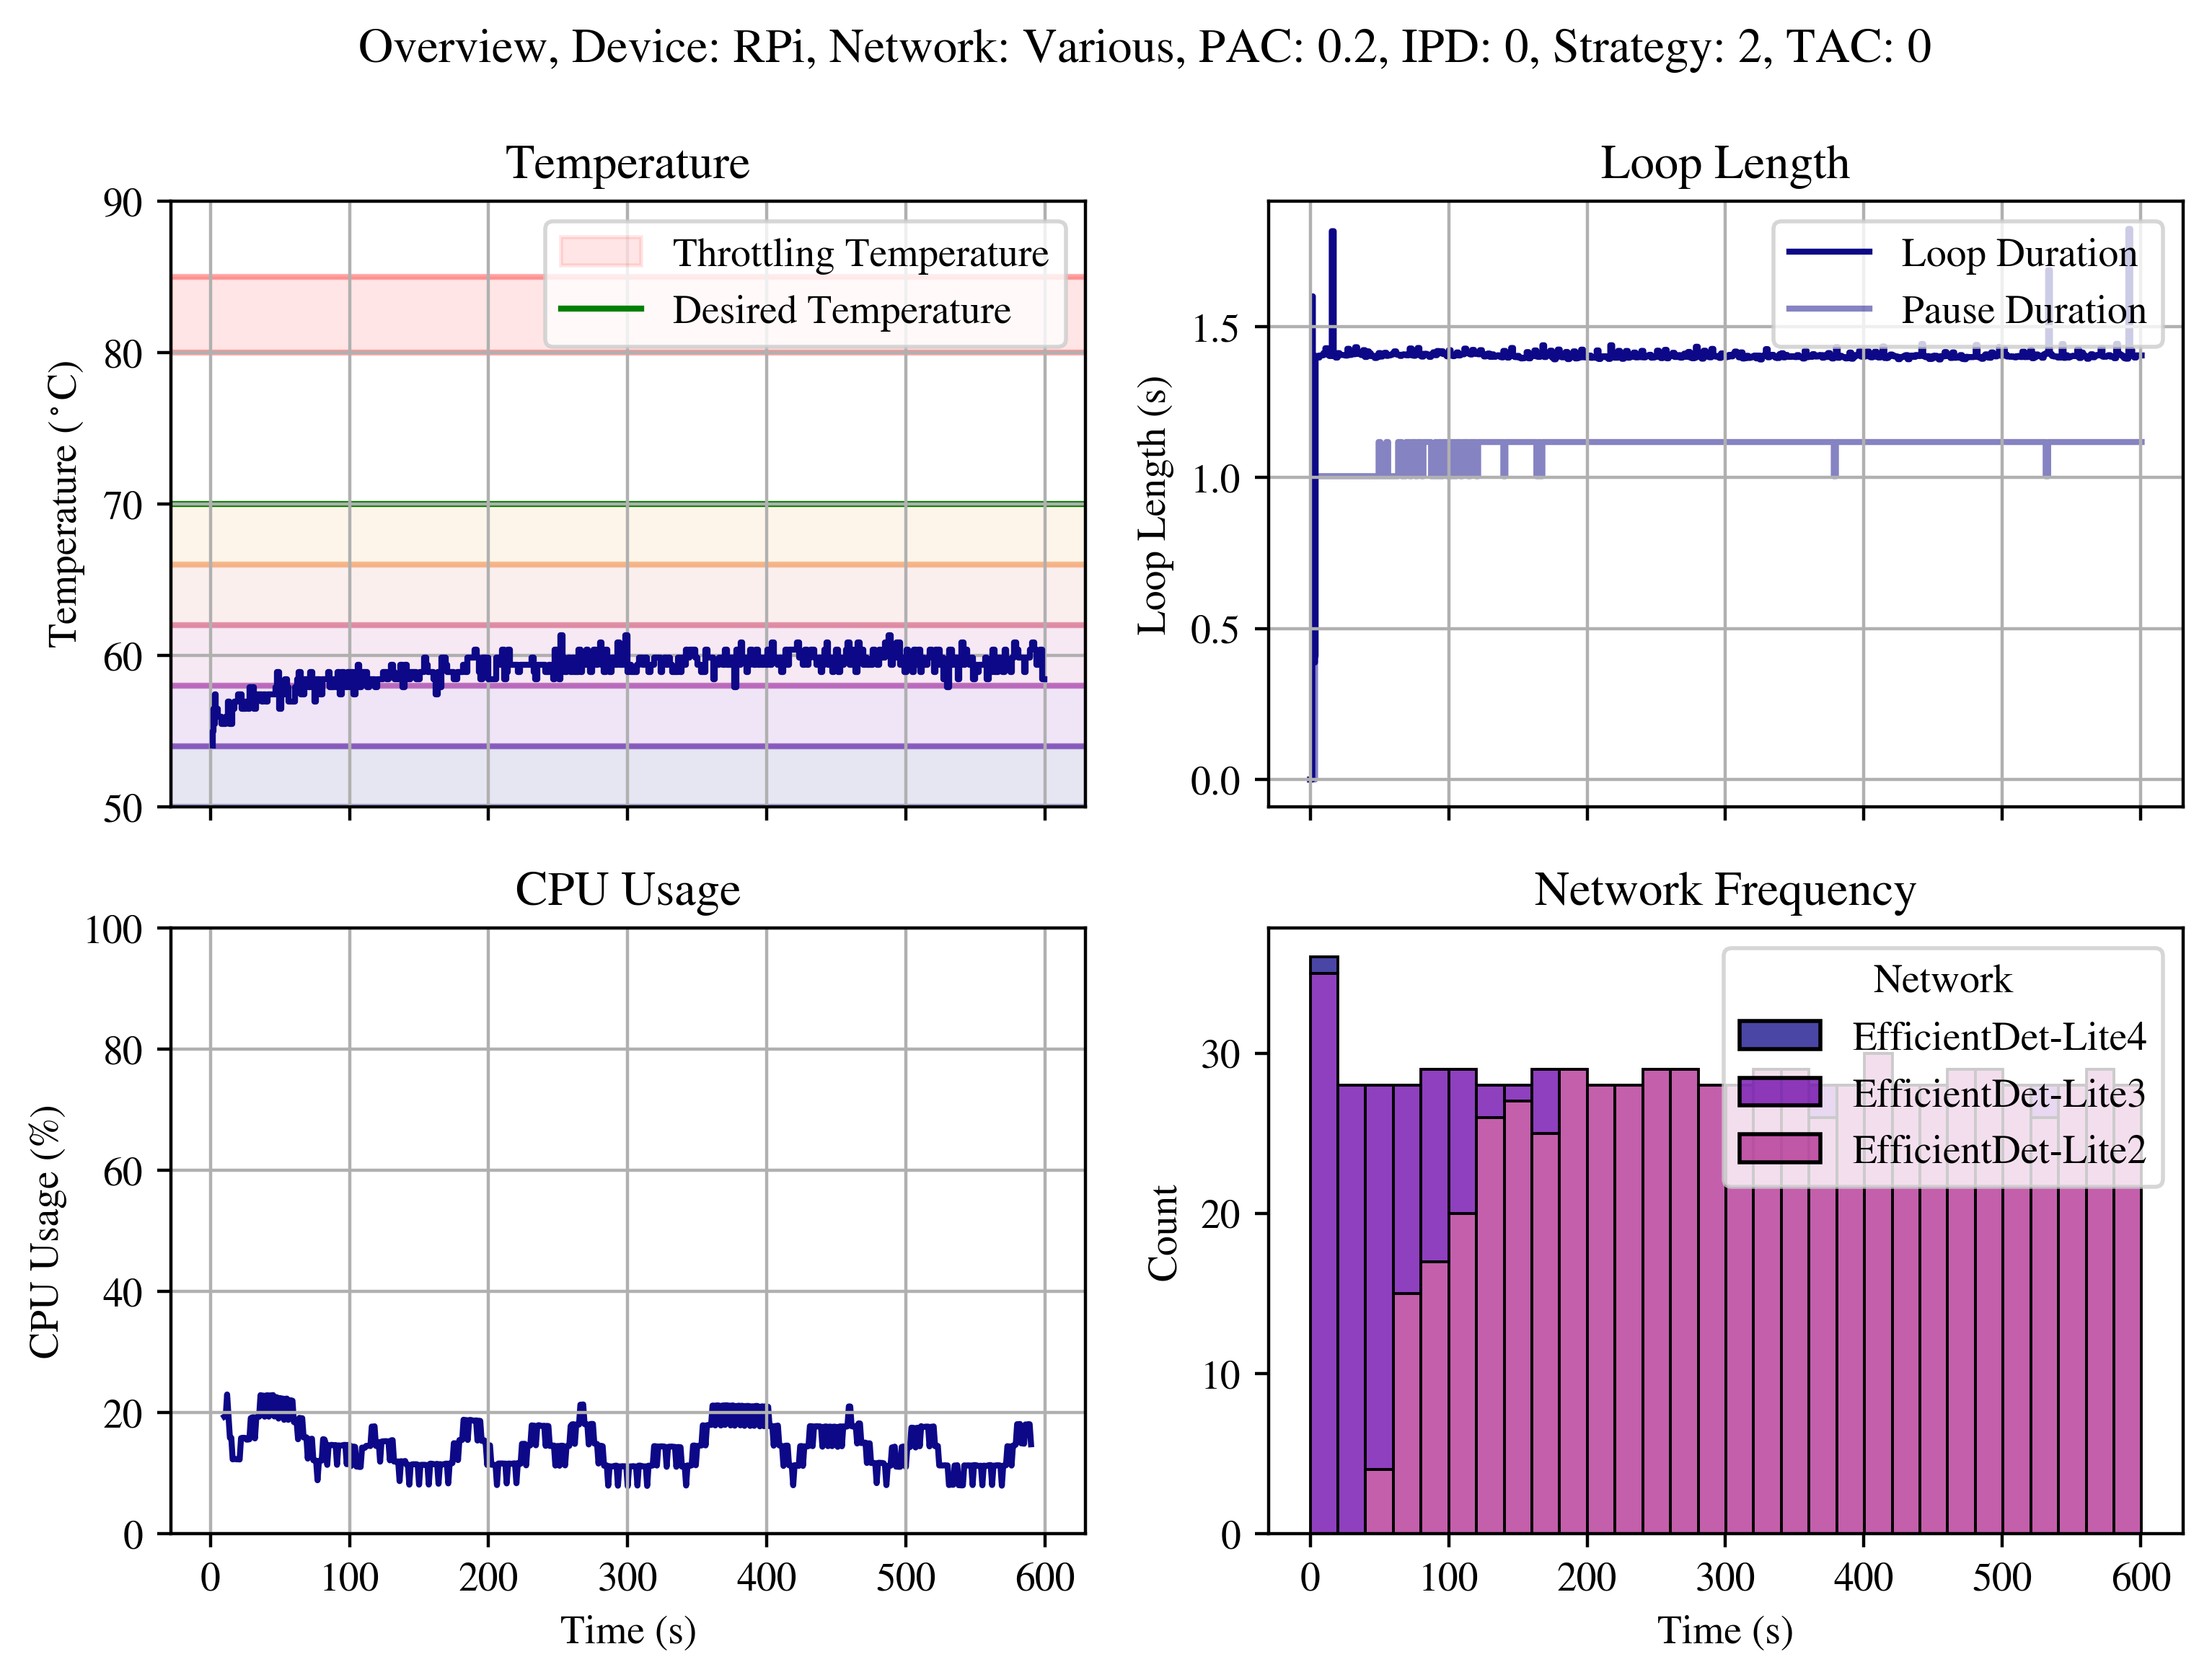
Backup Slide D

Slide 39

Backup Slide E

Slide 40
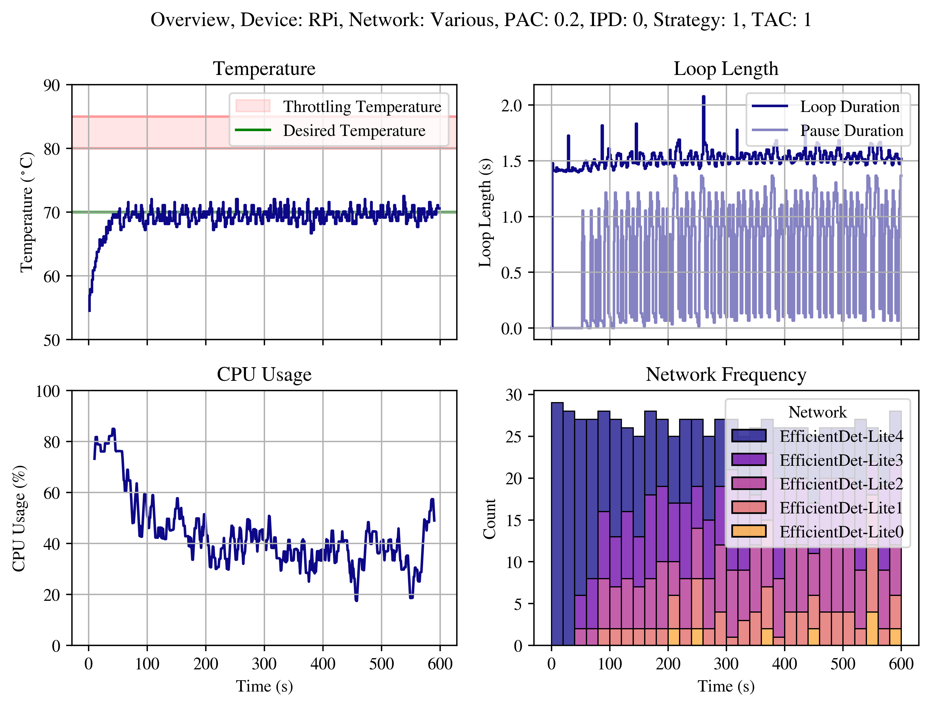
Backup Slide F

Slide 41
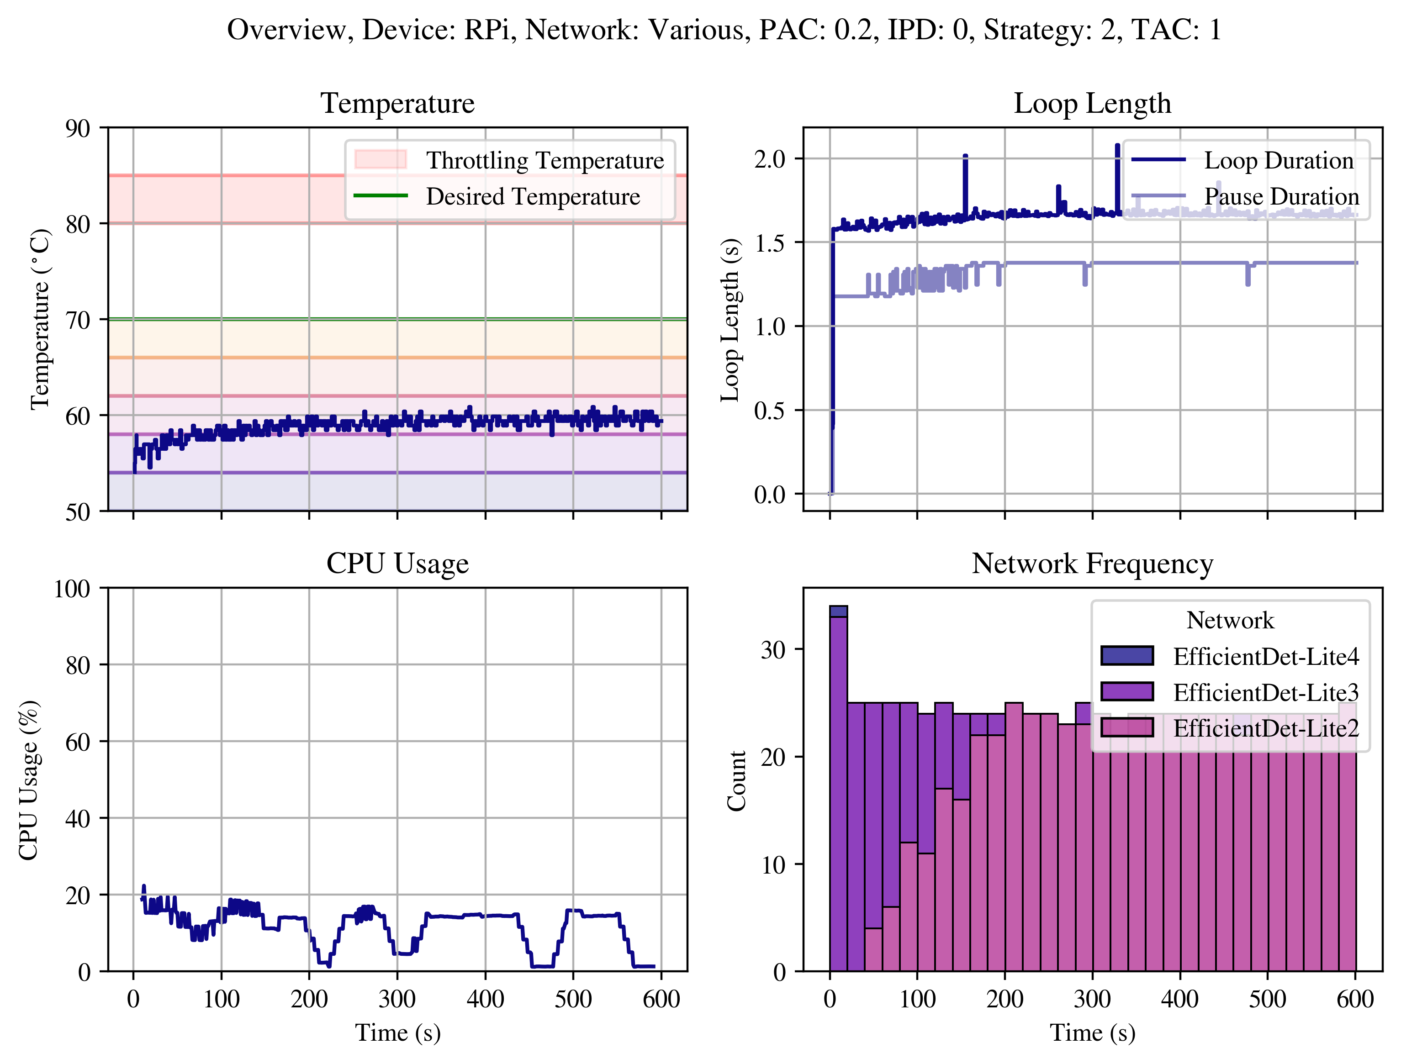
Backup Slide G

Slide 42
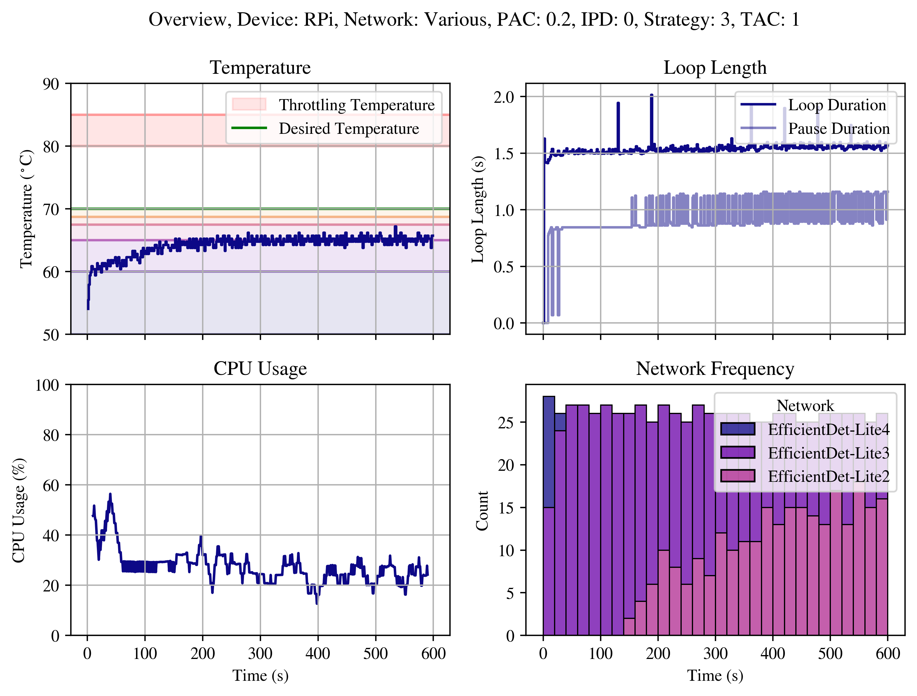
Backup Slide H

Slide 43
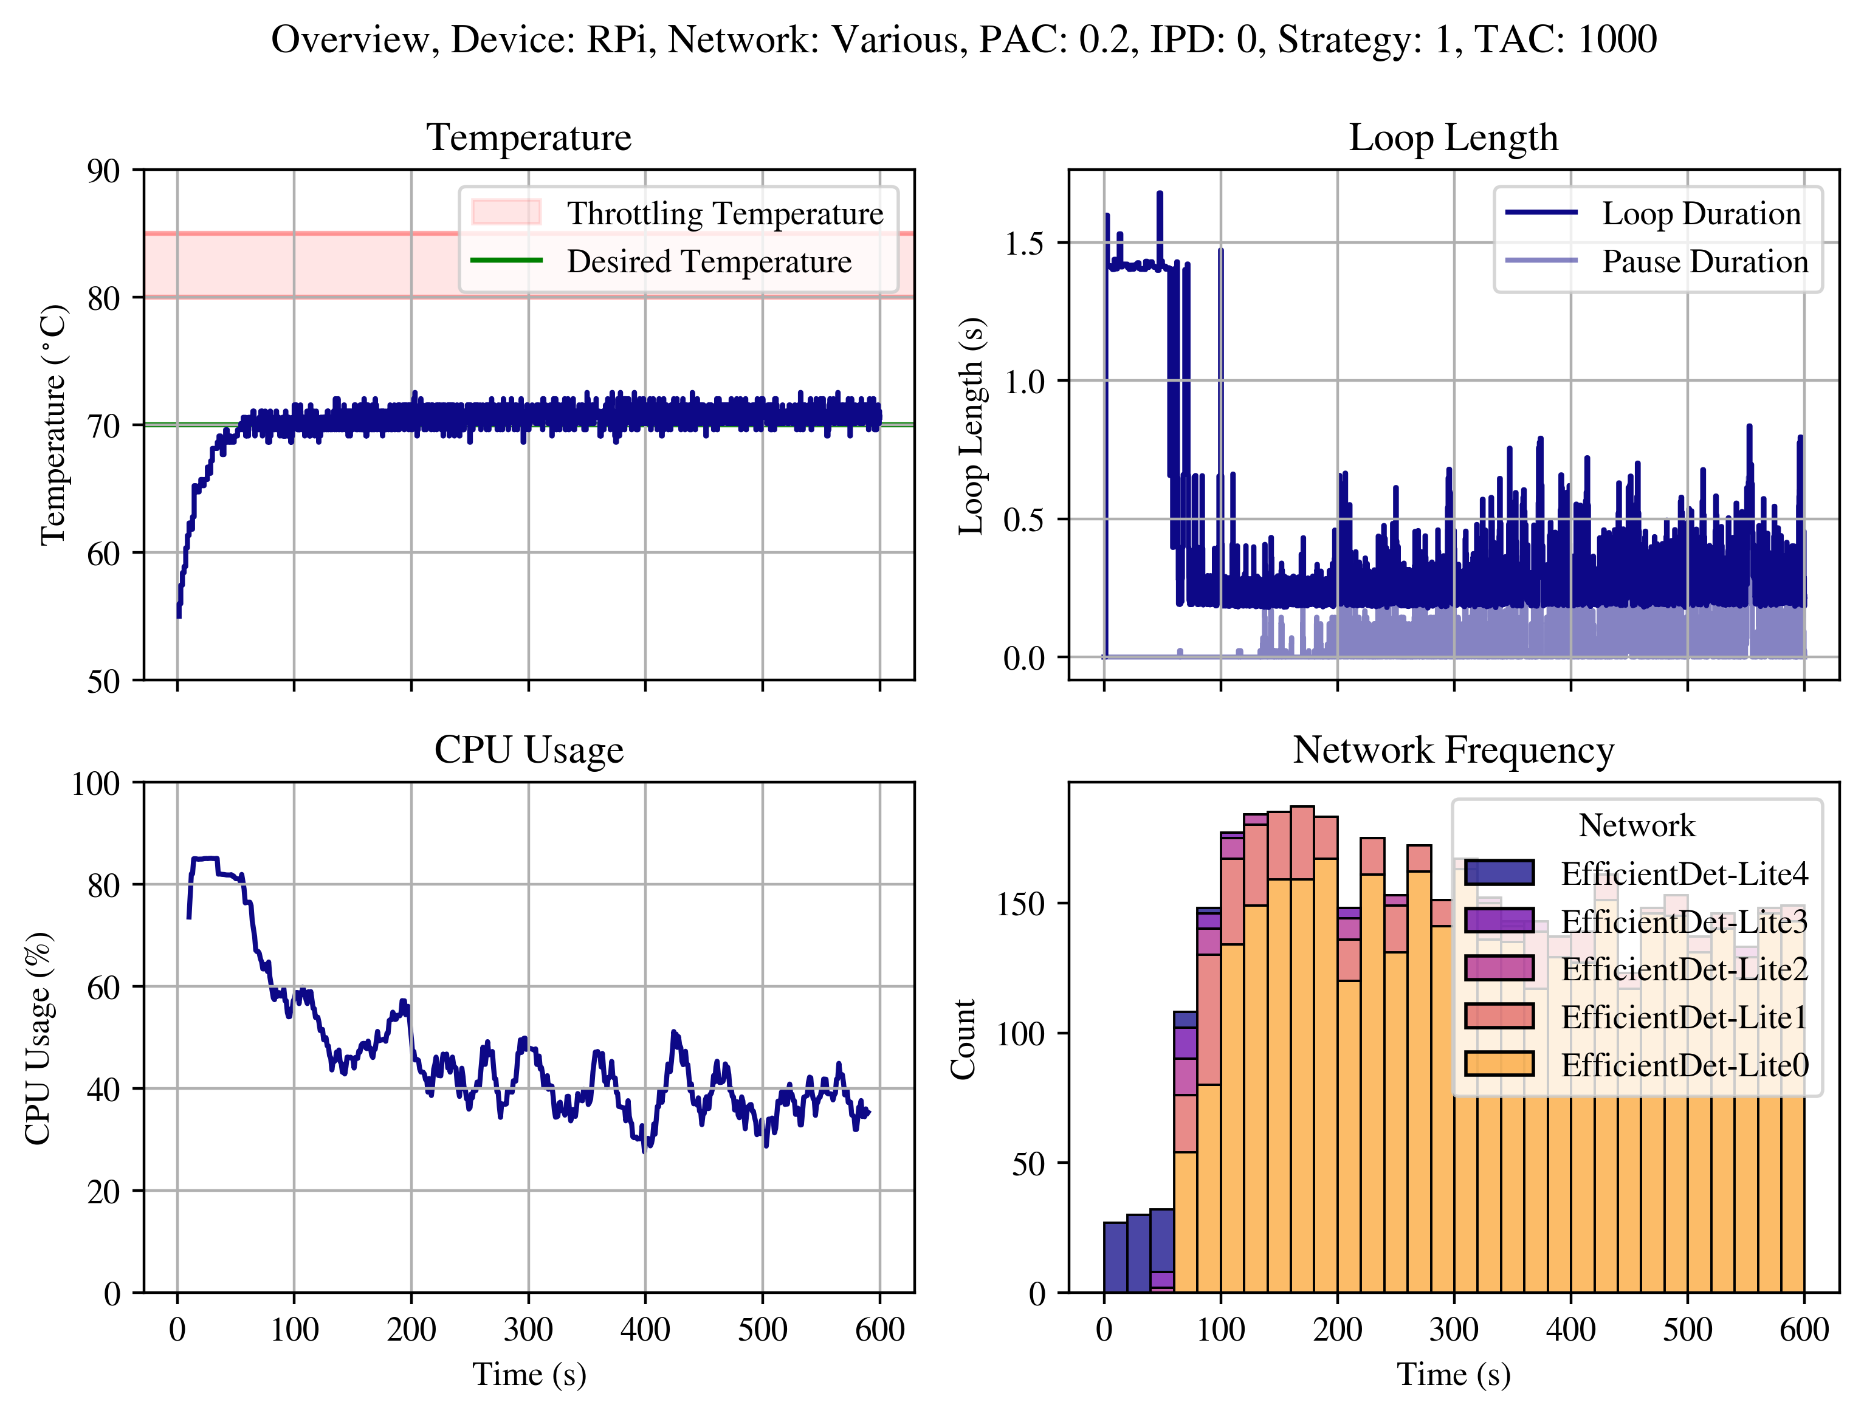
Backup Slide I

Slide 44
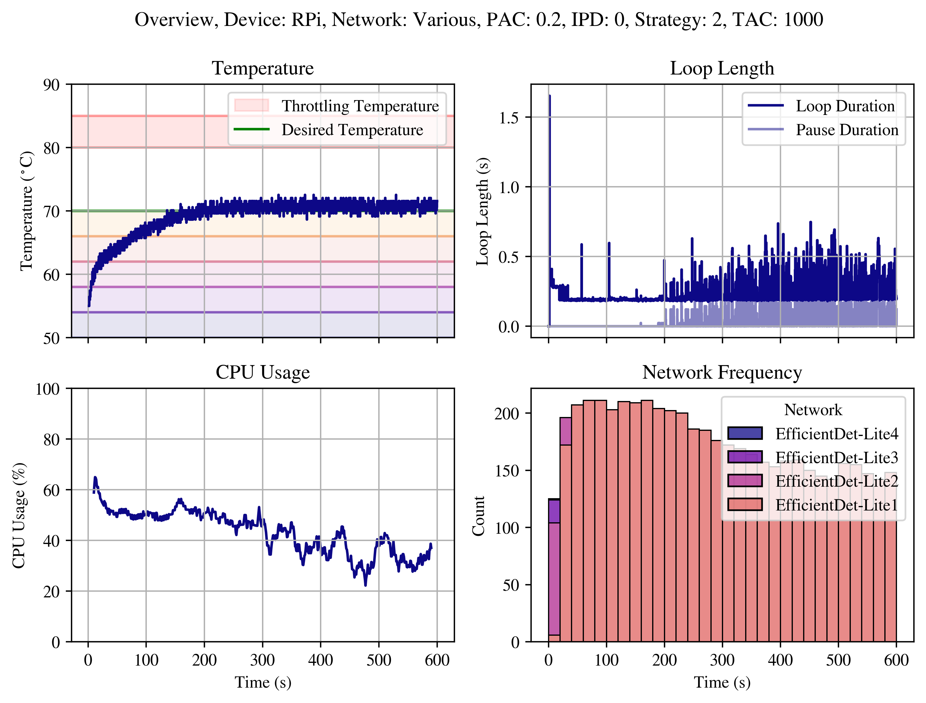
Backup Slide J

Slide 45
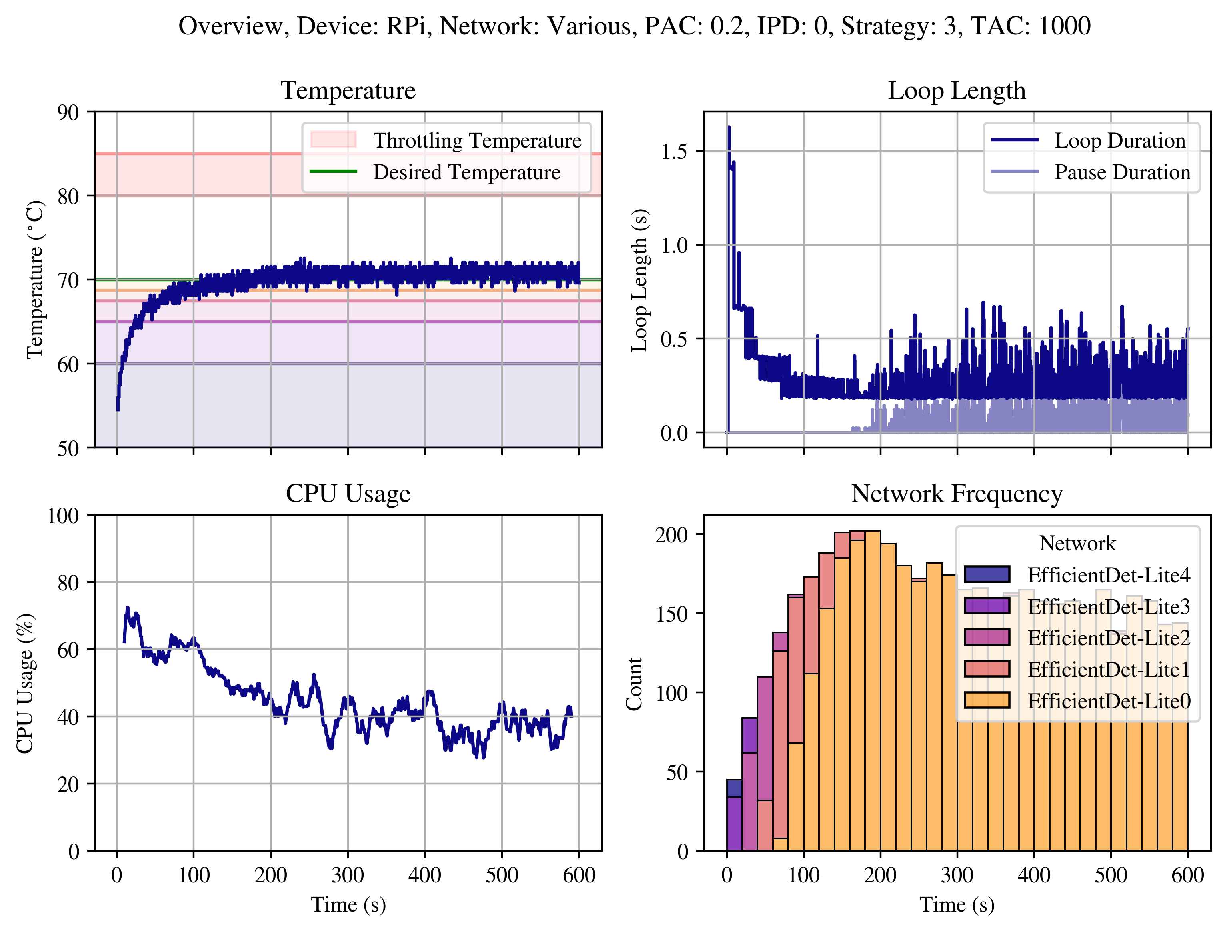
Backup Slide K

Slide 46
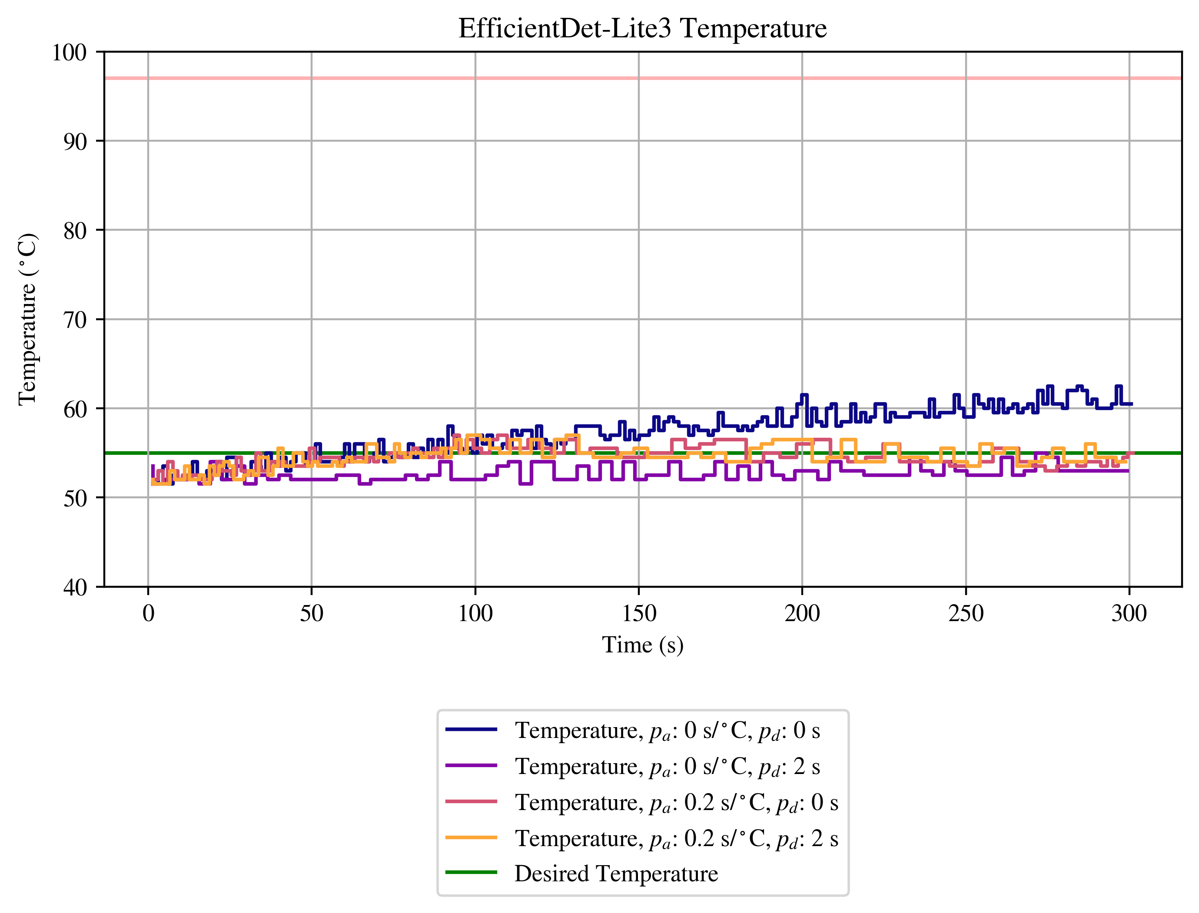
Backup Slide L

Slide 47
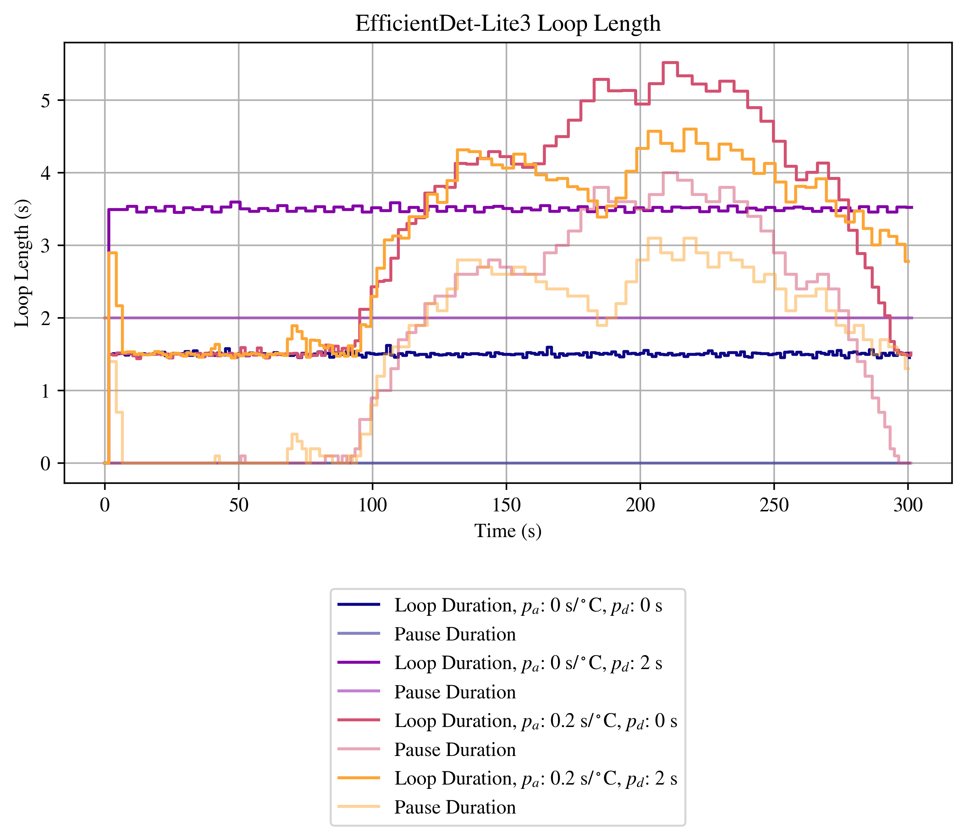
Backup Slide M

Slide 48
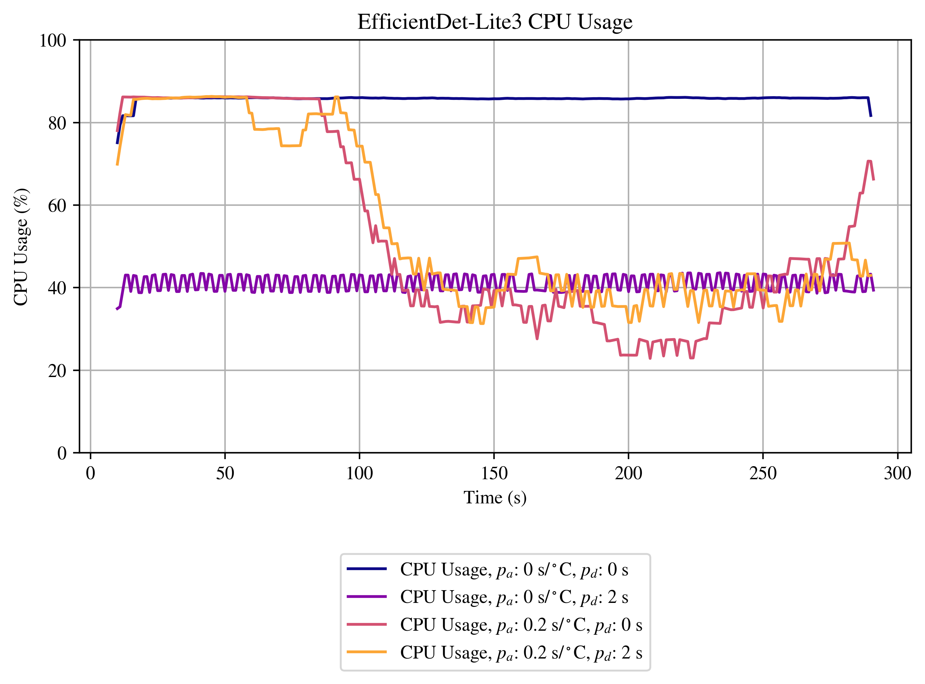
Backup Slide N

